Slide 1
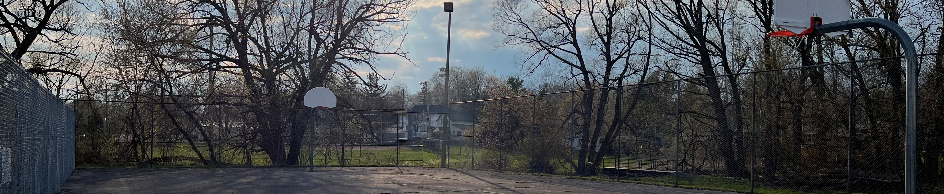
Cramahe Township
Parks & Recreation Committee
Update: Elgin Street Sports Park Rehabilitation
Notes:
Opening / Introduction
Hello, my name is ______ and I’m a volunteer with the Elgin Street Sports Park Revitalization Committee here in Colborne.
We’re leading a community campaign to revitalize and enhance the Elgin Street Sports Park for families, youth, seniors, and local organizations.
This is about strengthening one of our town’s most important recreation spaces for today — and for future generations. The following slides provide an overview of this initiative that we’re using to inform community stakeholders.

Slide 2
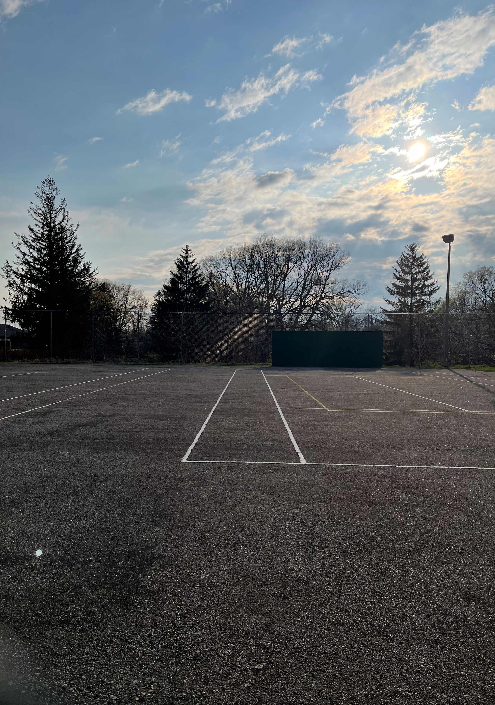
Agenda
1
About the Parks & Recreation Committee
2
The Elgin Street Sports Park
3
Activity since receiving Council’s Support
4
What’s Next? Fundraising!
5
Partnership with The Community Foundation of Campbellford/Seymor and Northumberland
6
Our Ask

Slide 3
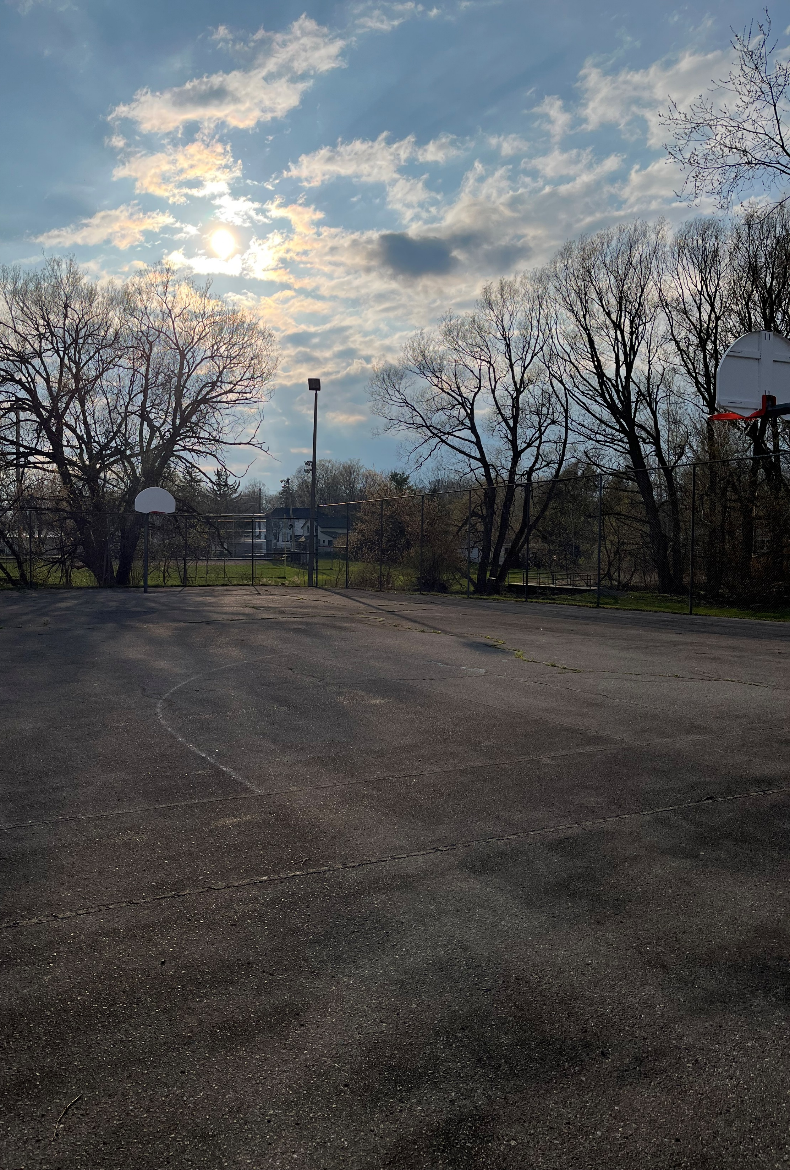
Parks & Recreation Committee
The Township of Cramahe encourages resident involvement through a variety of boards and advisory committees.
Our vision is to create a happy and healthy Township where Cramahe residents of all ages can play, learn, and build community.
Our mission is to promote quality recreation opportunities for all Cramahe residents through the creation and enhancement of parks, facilities, and activities.

Slide 4
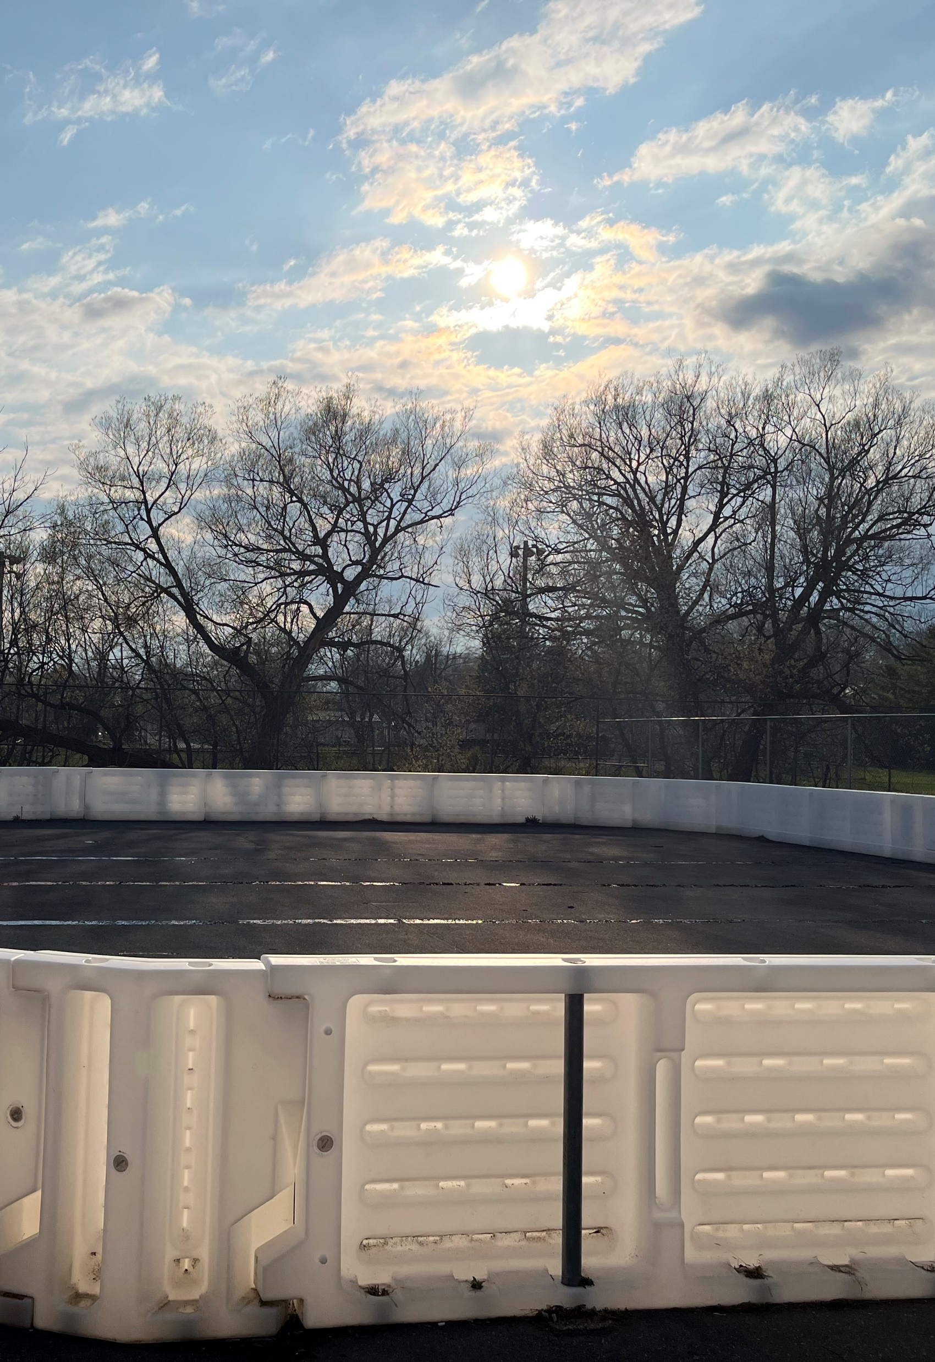



Our Inspiration for the
Sports Park Rehabilitation
Cramahe Township will continue to experience unprecedented growth with more than 700 homes currently approved to be built, and new applications being expedited as a result of the Province of Ontario’s Bill 23, More Homes Built Faster Act.
Our Committee wants to ensure this growth is positive for our community by creating spaces that:
Attract
Families
Develop the Skills of Future Leaders
Foster
Community

Slide 5
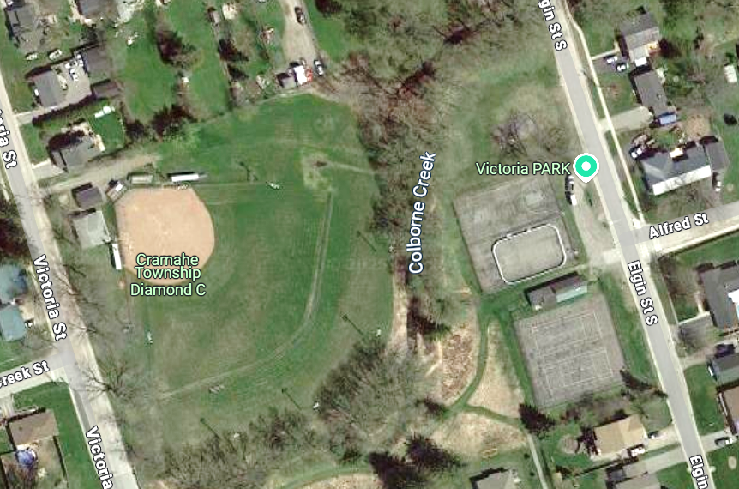
E l g i n S t r e e t
The Elgin Street Sports Park
Cramahe Township has a unique asset on Elgin Street, in the heart of Colborne, that would be the envy of most communities.
The space includes two tennis courts, a ball hockey rink, a basketball court, a baseball field, a clubhouse, and the potential for significant parking. Also, Colborne Creek bisects the park adding an idyllic environment for reading, picnics, or relaxation. However, the park’s facilities are approaching end of life.
This park, if rehabilitated, would be an ideal space for crucial community building activities such as sports camps, youth groups, sports clubs, family get-togethers, and much more!
C o l b o r n e C r e e k
V i c t o r i a S t r e e t

Slide 6
The Purpose of the Campaign
The park is a central gathering place for our community. It supports youth sports, walking trails, family picnics, tournaments, and community events.
Our goal is to upgrade and improve the facilities, so they remain safe, accessible, and vibrant for everyone.
This is a community-led effort — built by local people, for local people.
Why It Matters
Recreation spaces contribute to physical health, mental well-being, and community connection. The park brings together families, local businesses, schools, and sports organizations.
Improvements will benefit residents of all ages — from young children to seniors. A strong park helps build a strong Colborne.

Slide 7
E l g i n S t r e e t
Resolution No. 2023-228
Our committee was grateful to receive Council’s support for this initiative in 2023
BE IT RESOLVED THAT the Parks and Recreation
Advisory Committee requests that Council support the
Elgin Street sports park rehabilitation initiative; and
THAT Council authorizes the Parks and Recreation
Department to work with the Committee to investigate
funding opportunities (grants, fundraising and local
sponsorship) and project scoping (discussions with
contractors) and to support the Elgin Street sports park
rehabilitation initiative.
C o l b o r n e C r e e k
V i c t o r i a S t r e e t

Slide 8
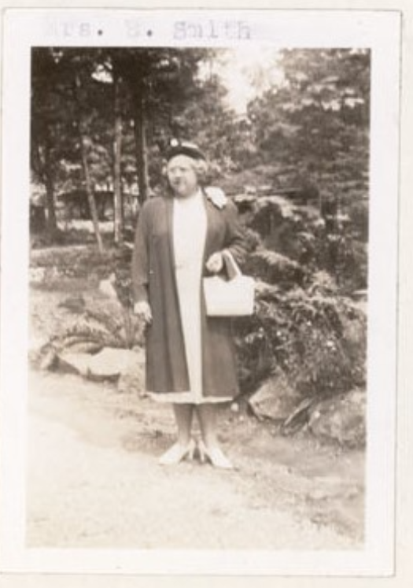
E l g i n S t r e e t
Since Council’s Resolution
Council has allocated ~$89,000 to this project through the Parkland Reserve Funds – THANK YOU!
Two grants have been applied for through the Ontario Trillium Fund (regrettably, both were unsuccessful)
The vision for the Park’s rehabilitation has been shared with the community through events like Touch-A-Truck, Skate with Santa, Movies in the Park, and with the Rotary Club
Also, the Committee shared the project vision with the Heritage Committee and hope they may consider recommending a name for this space
In 1944, Mrs. B. Smith generously gifted Cramahe Township the land on Elgin Street South for a recreation site. This land was given in memory of her father, John Coyle.

Slide 9
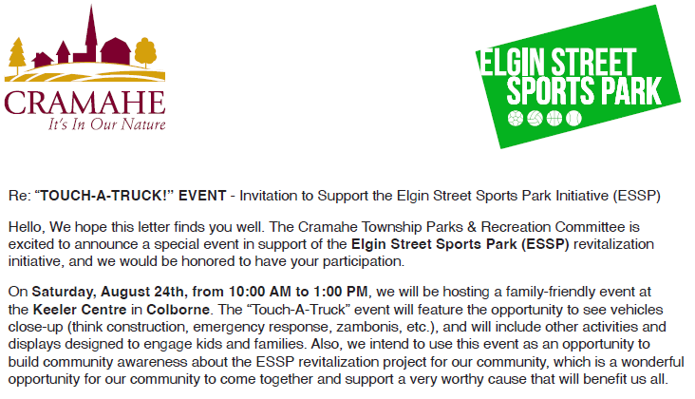
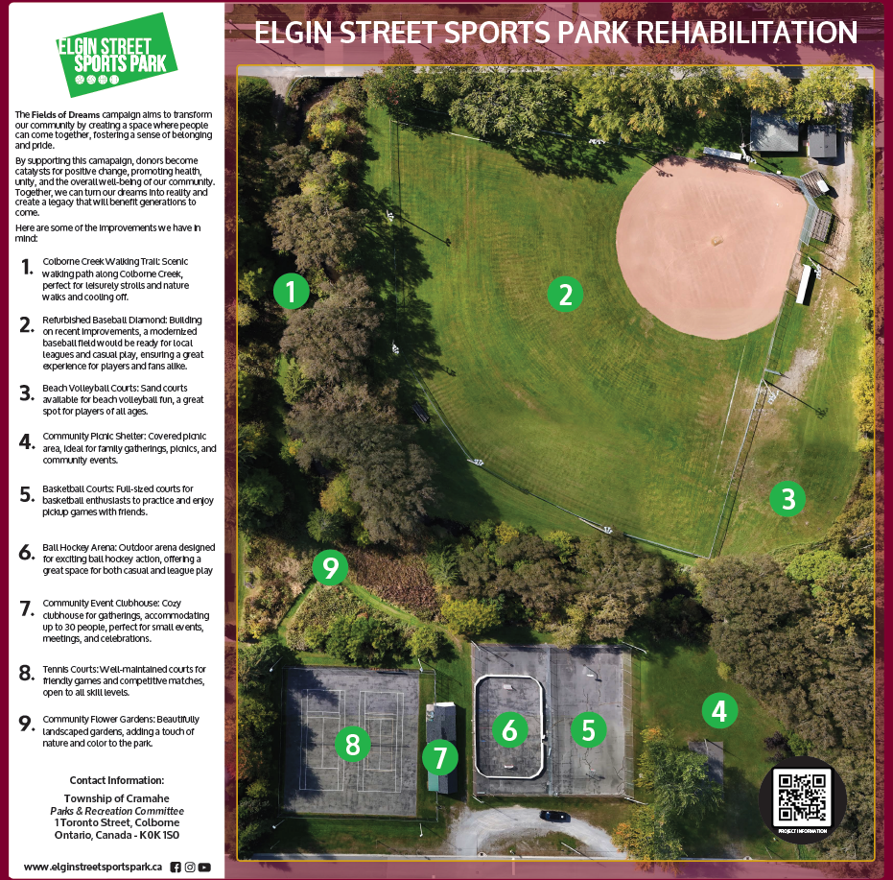

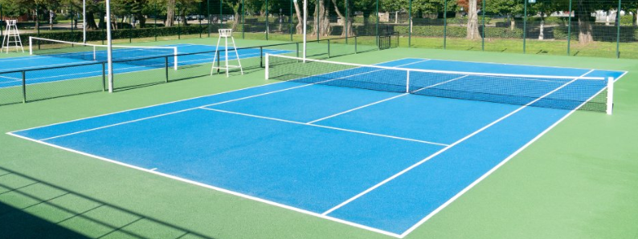
What’s Next? Fundraising!

Slide 10
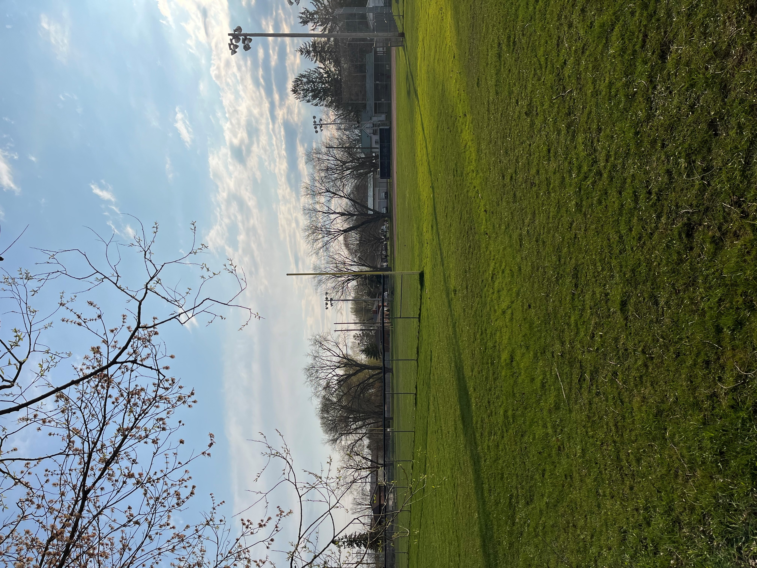
E l g i n S t r e e t
Fundraising for Phase 1
The committee has launched a fundraising campaign focused on the rehabilitation of the current assets in the park (Phase 1)
When Phase 1 is successfully completed, the Committee would like to explore with the community opportunities to add new assets to this and/or other locations. However, these would be subsequent phases and would not be part of the phase 1 scope
C o l b o r n e C r e e k
V i c t o r i a S t r e e t

Slide 11
E l g i n S t r e e t
Scope of Rehabilitation (Phase 1)
The scope for Phase 1 is as follows:
  Tennis court resurfacing (and repositioning)
  Basketball court resurfacing
  Ball hockey court repair and painting
  New basketball nets and hardware
  New fencing (as needed)
  New lighting
  Initial quotes for the completion of this work cost approximately $235,000
  Given the funding already provided by Council, the campaign will focus on raising up to $160,000

Slide 12

Managing Donations
The Community Foundation of Campbellford/Seymor and Northumberland is our partner to support fundraising activities by provide the following services:
1) CFCSN Prepares Charitable Tax Receipts for donors that make donations:
a) by cheque
b) by e-transfer
2) The CFCSN has an option for donors to make donations on-line through CanadaHelps,
which is a secure online donation portal, which we could leverage, as follows:
a) Donations can be made by credit card, and the charitable receipting is provided by Canada Helps
b) Fees charged by Canada Helps (3.5%-4%) for credit card payment would be deducted from the donation amount
Donate Now via CanadaHelps:

Slide 13



Our Ask
The Committee is looking to inform community residents and businesses about our fundraising initiative. Thank you for taking the time to speak with us today!
There are numerous ways you can support us:
Make a donation!
    All contributions will have a direct and lasting impact.
Spread the word!
    Tell your friends and colleagues about our fundraising initiative.
Make our project part of your corporate initiatives
    We would love the opportunity to take part in meetings or events to help spread our message

Slide 14
Questions?

