Slide 1
NAVIGATING STRESS:
THE HIGH SCHOOL TRANSITION
PRESENTED BY:
The BWell Group

Slide 2

BOARD MISSION STATEMENT
“Together for Mental Health: Everyone, Everyday”

Slide 3

01.
What is the BWell Group?
BWell Group
  Group that aims to promote positive mental health throughout the school community
  Let’s take a closer look!

Slide 4
Our Events and Initiatives!

Slide 5
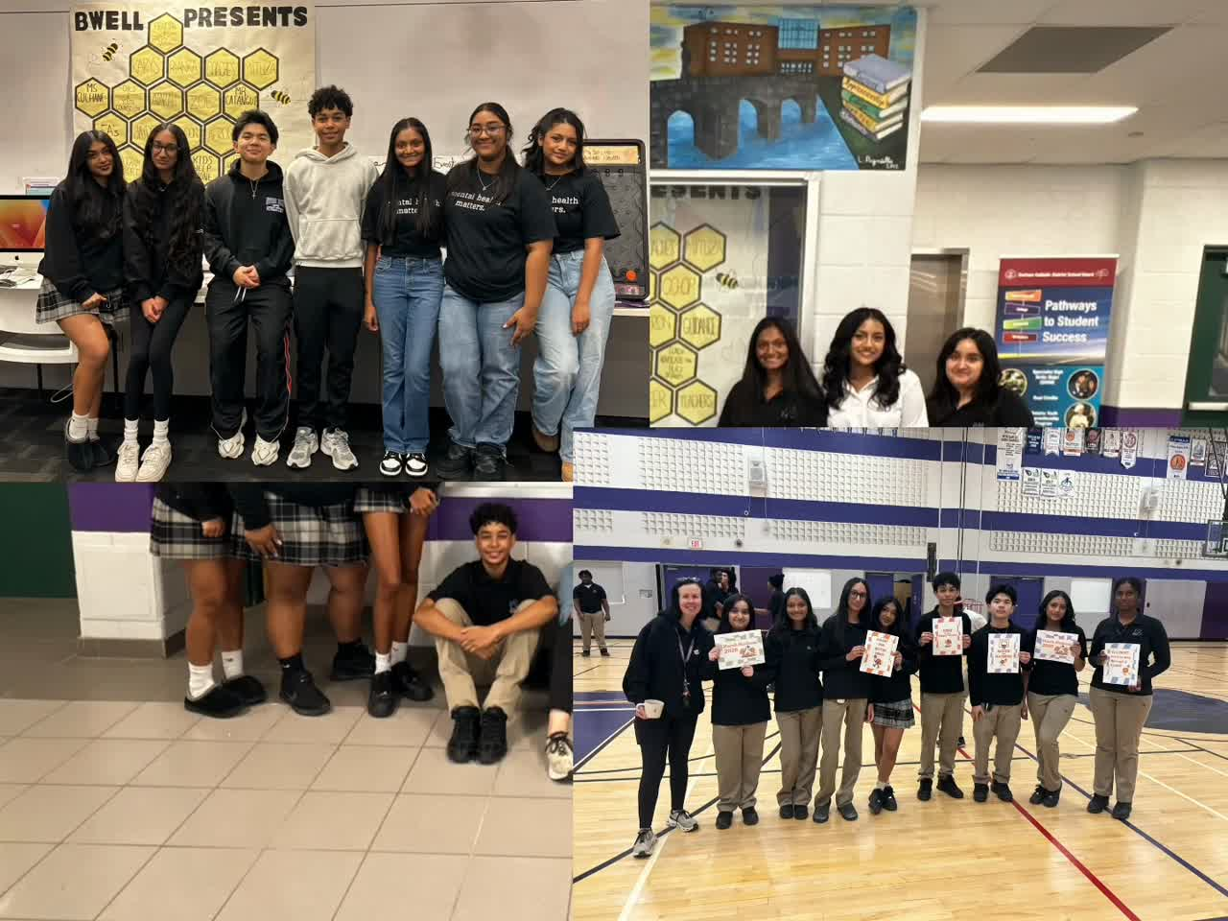
Notes:
Feel free to add in what your school does to promote well-being here.

Slide 6

02.
Table of Contents
  Group Discussion: Your Feedback
  Myths about High School
  Our Experiences at High School
  Tips & Available Resources
  SURPRISE!

Slide 7

03.
Your Feedback
It is natural to feel both excited and anxious for high school!
WHAT ARE WE EXCITED FOR?
  Making new friends
  Joining new clubs
  Going out for lunch
WHAT ARE WE ANXIOUS ABOUT?
  Exams
  Meeting deadlines
  Strict teachers

Slide 8

Facts or Myths?
04.
  All teachers are intimidating and unapproachable
  Senior students bully younger students
  Time management becomes more important in high school.
  It is impossible to do well in a class after having one “bad” test.
  It is okay to not have your entire future planned in grade 9.
  Making new friends is always beneficial.
  Exams assess topics outside of what is taught in class.

Slide 9

Check-in Time:
What are some of your worries?

Slide 10
05.
Support
Resources
In highschool, you can ALWAYS talk to:
  The Principal
  Vice Principals
  Guidance Counsellors
  The Chaplain
  Child and Youth Counsellor
  Social Worker
  Teachers
  Custodians
  Secretaries/Administrative Staff

Slide 11
06.
Our Tips and Tricks

Slide 12

Time-Management
  Often, stress stems from feeling overwhelmed or “stuck”.
  We can navigate this by:
    Creating a REALISTIC “To-Do List”
  Helps to prioritize tasks!

Slide 13
Effective Study Techniques
Mind Maps
Active Recall
Study Groups
1) Write the topic at the center of the page
2) Jot down connected topics all around the title
Why is it effective?
  Helps to visually connect all the information
1) Make practice questions or flashcards
2) Anything that exposes you to the lesson material regularly!
Why is it effective?
As students, we learn best when we see concepts over and over again!
1) Organize a time, date, and place to review concepts as a GROUP
Why is it effective?
  Peers can help answer questions in a more understandable way
  Teaching topics to others helps you understand as well

Slide 14
07.
Tips and Tricks
  Ask for help sooner rather than later
  Complete your homework as it is given
    Even if your teacher does not check it
  Find a balance between school work and having fun
  Get involved in extracurriculars
  Find healthy ways to manage stress
  ENJOY YOUR TIME IN HIGH SCHOOL
    IT FLIES BY!

Slide 15
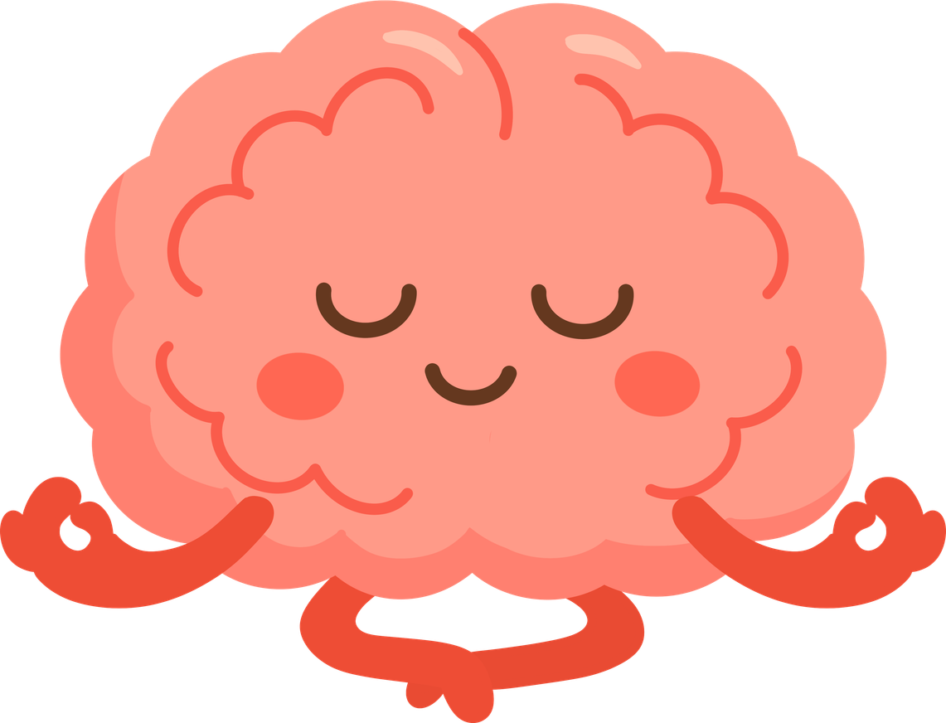
How should we manage stress?
  Share concerns with a trusted person in your life
  Try boxing breathing techniques/meditation
  Yoga or exercise
  Listening to music
  Making time for fun activities, even when stressed

Slide 16
THANK YOU FOR LISTENING!
PRESENTED BY: THE BWELL GROUP

