Slide 1
By-Law Review
Examples of Sign Placement

Slide 2
Maximum Sign Size
1.22 metres (4 feet)
1.22 metres (4 feet)
Notes:
Compliant
By-Law 2538 – 4.1(a)

Slide 3
Maximum Sign Height
1.5 metres (5 feet)
Notes:
Compliant
By-Law 2538 – 4.1(b)

Slide 4
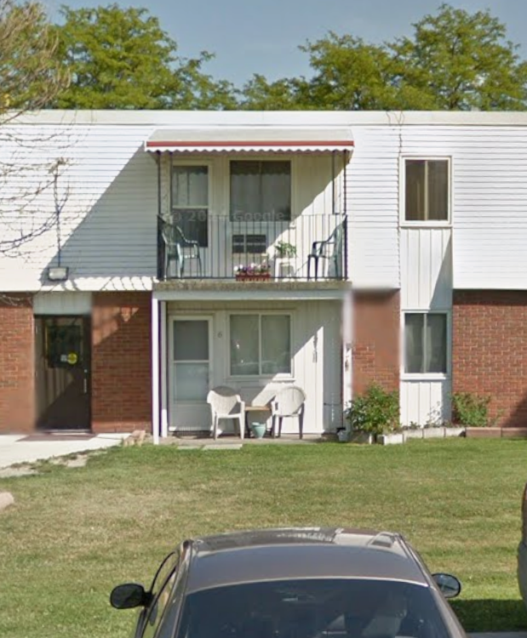
Maximum sign height excludes signs that are displayed on balconies or windows of a residence or apartment.
SIGN

Slide 5
Municipal Elections Act, 1996
Display of signs at residential premises
88.2 (1) No landlord or person acting on a landlord’s behalf may prohibit a tenant from displaying signs in relation to an election on the premises to which the lease relates. 2016, c. 15, s. 46.

Slide 6
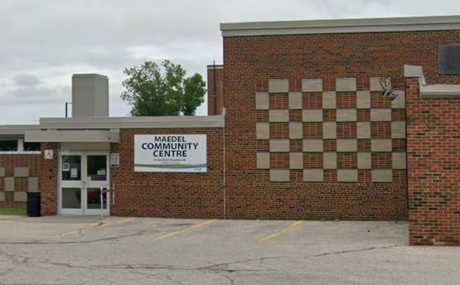
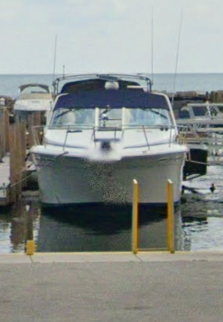
SIGN
SIGN
Notes:
Non-compliant
By-Law 2538 – s 4.1(h) Affixed to boat, airplane or dock on the water, including amphibious water sign
4.3 on any building owned leased or maintained by Town including - Community Centres

Slide 7
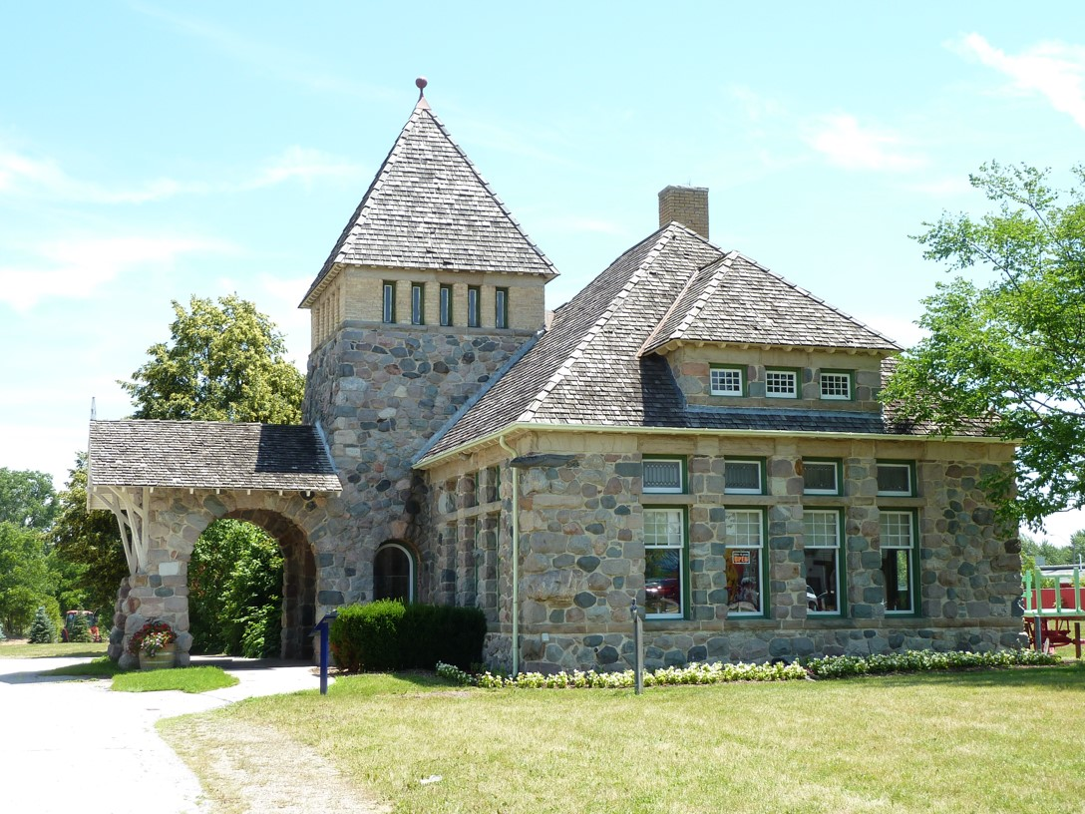
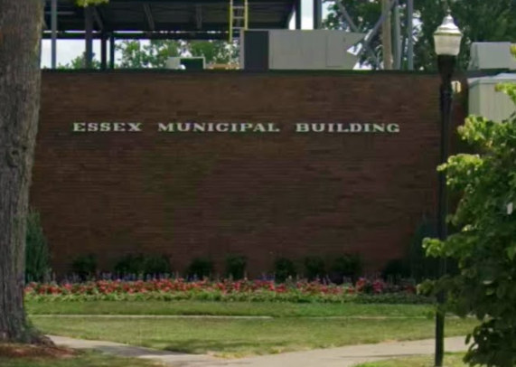
SIGN
SIGN
Notes:
Non-compliant
By-Law 2538 – s 4.2(a) or on any property owned, leased, maintained or under control of the Town, including Municipal offices and 4.3 Municipal Parks

Slide 8
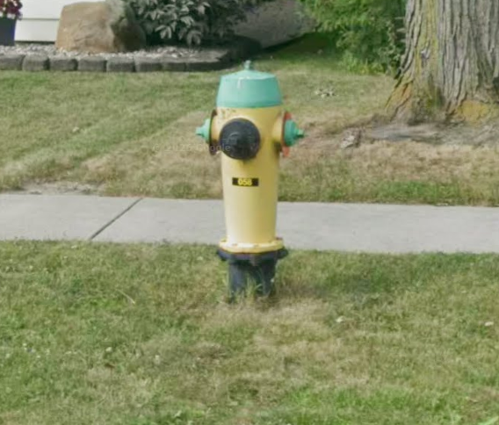
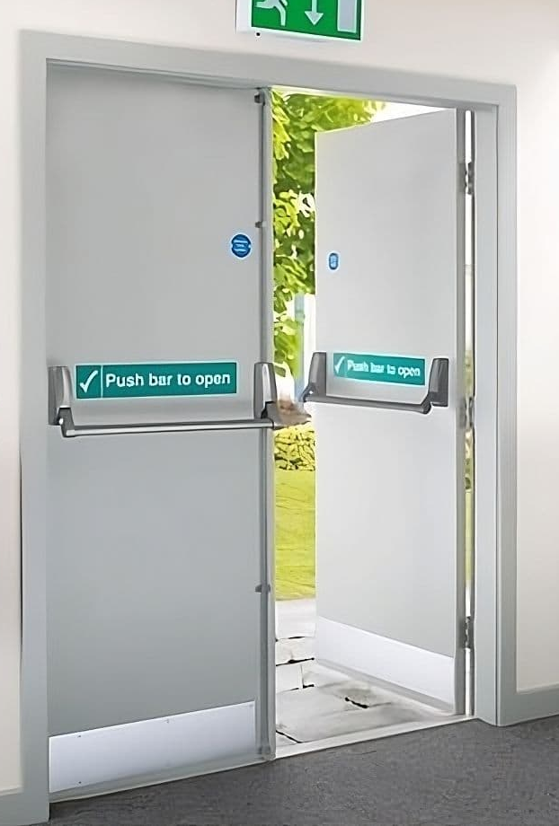
SIGN
N
Notes:
Non-compliant
By-Law 2538 – s 7.4
Obstruct or impede any fire escape, fire exit, door, window, flue, air intake or exhaust nor to prevent or impede the free access of emergency personnel to any part of the building, including any water connection or fire hydrant.
THIS IS A SAFETY ISSUE

Slide 9
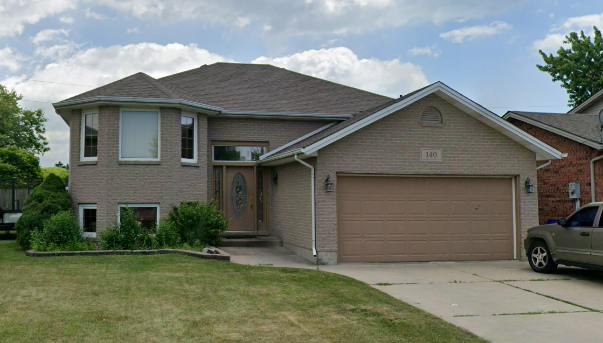
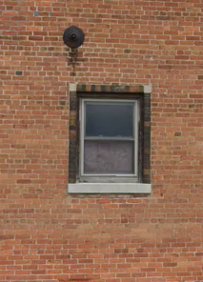
SIGN
SIGN
SIGN
Notes:
Non compliant S7.4 by obstructing a window, but compliant if a property owner or tenant decides to post on their windows or doors

Slide 10
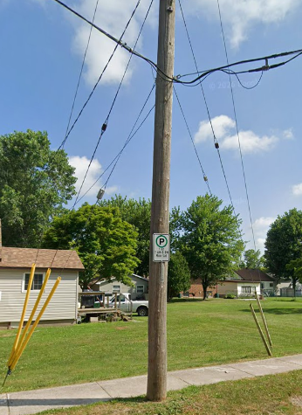
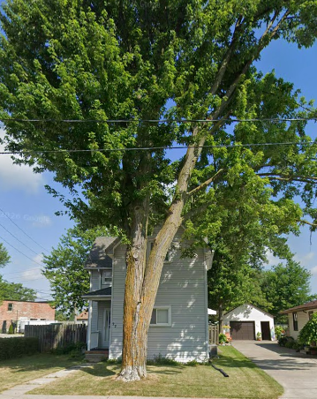
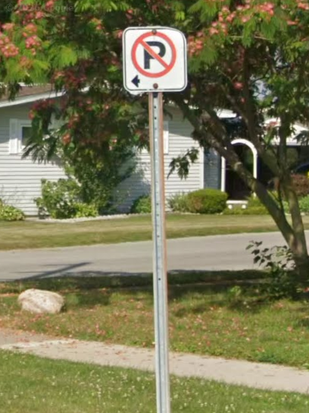
SIGN
SIGN
SIGN
Notes:
Non-compliant
By-Law 2538 – s 7.5 No election sign shall be affixed to a Tree, pipe, telephone pole, hydro pole, light standard or any other utility infrastructure

Slide 11
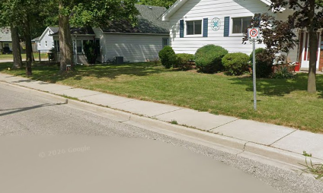
SIGN
SIGN
S 4.1(c): interferes with the safe operation of vehicular traffic or the safety of pedestrians
S 4.1(j): is located on a sidewalk
S 9.1(a): is on a roadway
S 9.1(b): impedes or obstructs the passage of pedestrians where they are reasonably expected to walk
SIGN

Slide 12
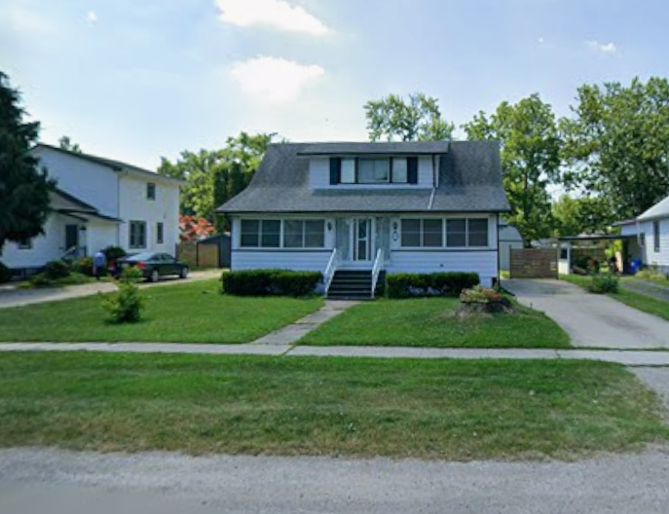
Only permitted to place one double-sided election sign on a private property
SIGN
Notes:
Compliant
By-Law 2538 - s 8.1

Slide 13
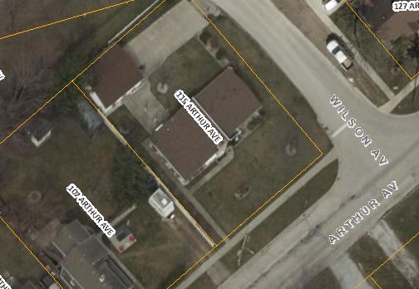
If a property abuts more than one roadway, then you may place a sign facing each roadway
>= 1 metre
Notes:
Compliant
By-Law 2538 - s 8.1

Slide 14
< 1 metre
Provided the signs are placed a minimum of one metre apart
Notes:
Non-compliant
By-Law 2538 - s 8.1, 4.1(j)

Slide 15
>= 1 metre
Cannot abut the same roadway
2 signs abut 1 roadway
Notes:
Non-compliant
By-Law 2538 - s 8.1

Slide 16
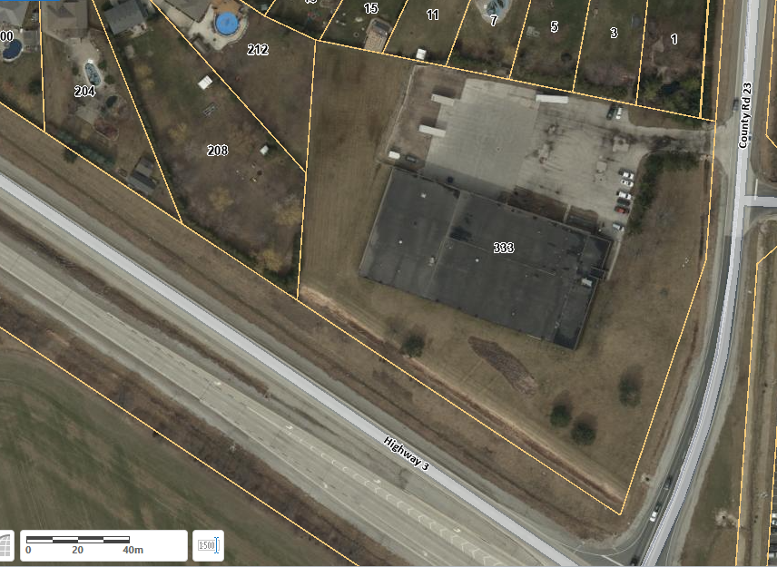
> 1000 metres of frontage
Notes:
Compliant
By-Law 2538 – s 8.2, Permitted one election sign for each 500 metres of commercial frontage

Slide 17
> 1000 metres of frontage
Notes:
Non-compliant
By-Law 2538 – s 9.1(e), Do not place a sign that is within 3 meters of an industrial property line

Slide 18
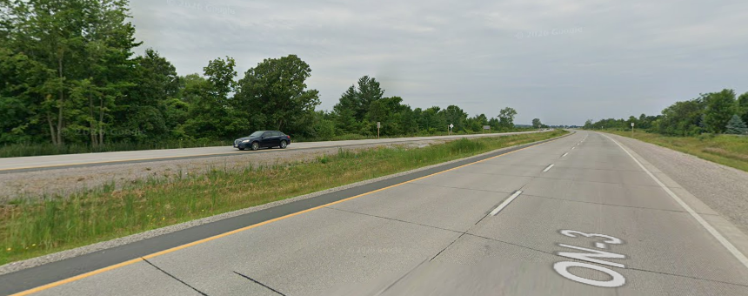
Do not place an election sign where it is on a median or island located within any roadway
SIGN
Notes:
Non-compliant
By-Law 2538 – s 9.1(f)

Slide 19
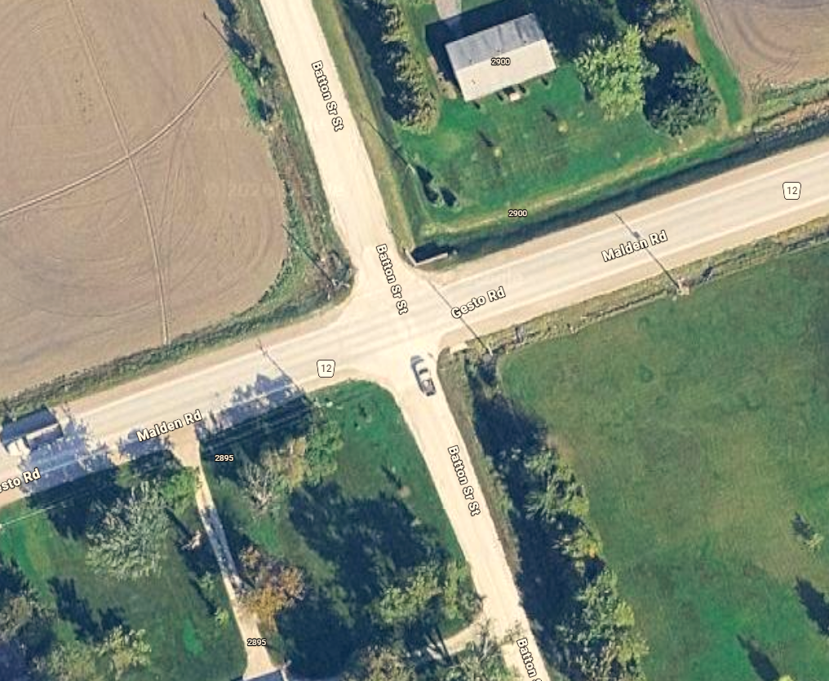
Notes:
Non-compliant
By-Law 2538 – s 4.1 (e) cannot obstruct the visibility of intersections

Slide 20
Notes:
Compliant
By-Law 2538 – s 4.1 (e) cannot obstruct the visibility of intersections or private entrances

Slide 21
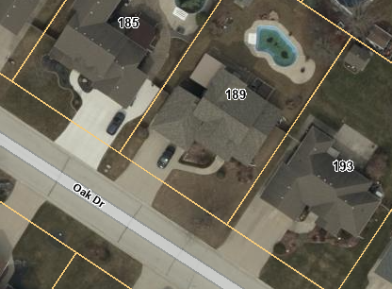
< 1 metre
Notes:
Non-compliant
By-Law 2538 – s 9.1(d)

Slide 22
>= 1 metre
Notes:
Compliant
By-Law 2538 – s 9.1(d) signs on private property cannot be within 1 metre of a residential property line

Slide 23
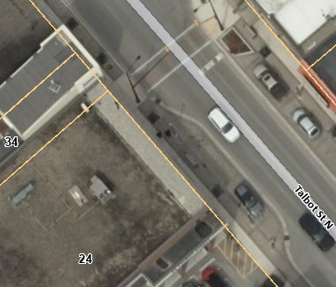
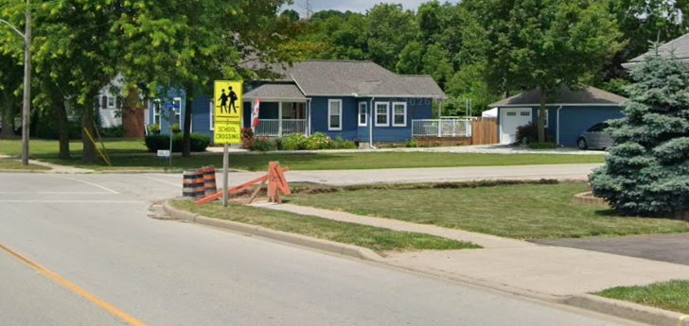
SIGN
< 10 metres
< 3 metres
Signs cannot be placed within 3 metres of a school crossing or 10 metres of an intersection pedestrian signal
Notes:
Non-compliant
By-Law 2538 – s 9.1(g), 9.1(h)

Slide 24
SIGN
>= 3 metres
>= 10 metres
Notes:
Compliant
By-Law 2538 – s 9.1(g), 9.1(h)

Slide 25
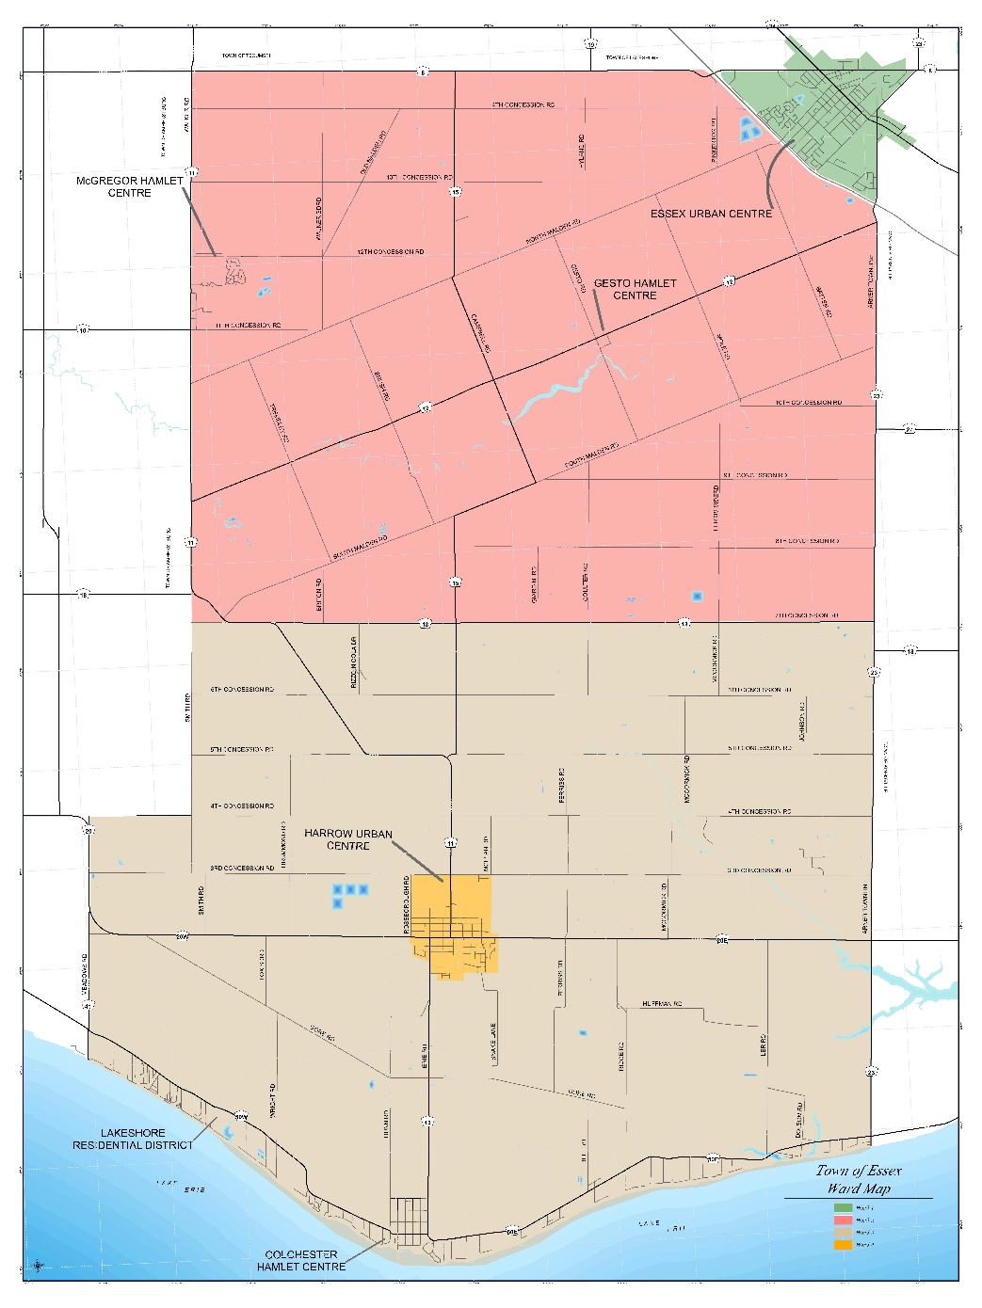
Ward Boundaries
Deputy Mayor
Signs can only be placed in the ward that the candidate is nominated in. Mayor, Deputy Mayor and Third Party Advertisers are able to place signs in any ward.
WARD 1
WARD 3
Notes:
Section 7.2
Unless nominated for the office of Mayor or Deputy Mayor in a municipal election, no person shall Place or permit to be Placed an Election Sign with regard to such election in any ward that they are not officially nominated as a Candidate or registered as a Third Party in.

Slide 26

Online Mapping Tool
Go to: www.essex.ca
Click on the Live tab
Select Maps
Under Online Mapping
Select: Interactive Mapping Service

Slide 27
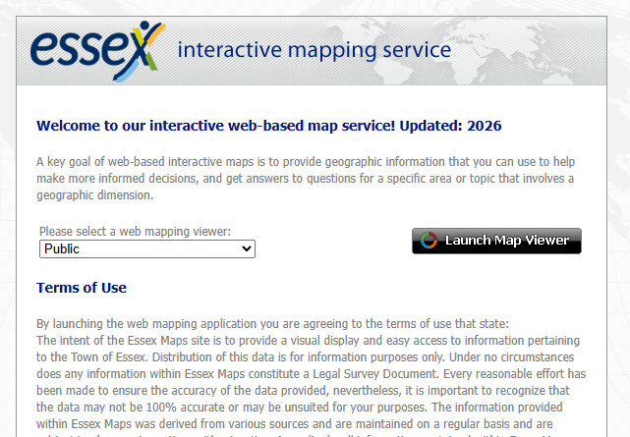
Online Mapping Tool
Select: Launch Map Viewer
This opens a new window.
Agree to Terms and Conditions to
access interactive map.
On the map tool, you can use the
button in the upper left-hand corner
to navigate the map features.
I want to…

Slide 28
Polling Locations
Notes:
10.1 On any day when electors are casting their ballots, no person shall place any elections signs on land within 100m of a Voting Place, unless such land is a residential private property

Slide 29
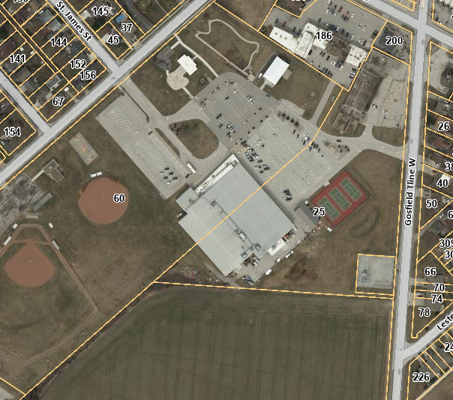
Polling Location
Essex Arena
< 100 metres
Notes:
Non-compliant
By-Law 2538 – s 10.1

Slide 30
Polling Location
Essex Arena
>= 100 metres
Notes:
Compliant
By-Law 2538 – s 10.1

Slide 31
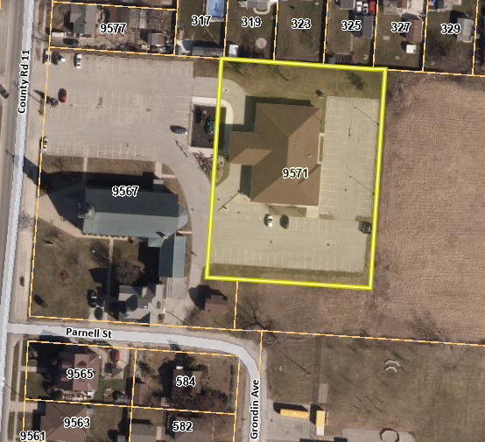
Polling Location
McGregor Community Centre
< 100 metres
Notes:
Non-compliant
By-Law 2538 – s 10.1

Slide 32
Polling Location
McGregor Community Centre
< 100 metres
However, located on a residential property.
Notes:
Compliant
By-Law 2538 – s 10.1

Slide 33
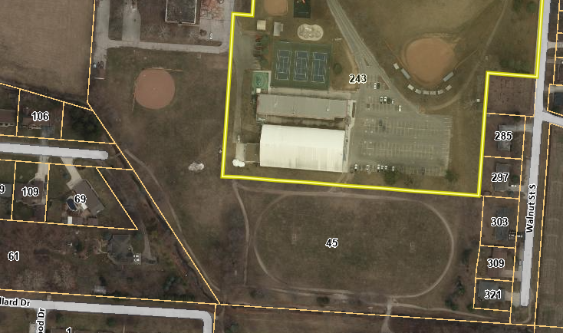
< 100 metres
Polling Location
Harrow Arena
Notes:
Non-compliant
By-Law 2538 – s 10.1

Slide 34
< 100 metres
However, located on a residential property.
Polling Location
Harrow Arena
Notes:
Compliant
By-Law 2538 – s 10.1

Slide 35
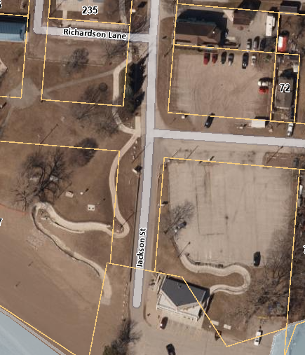
Polling Location
Colchester Harbour
< 100 metres
Notes:
Non-compliant
By-Law 2538 – s 10.1

Slide 36
Polling Location
Colchester Harbour
>= 100 metres
Notes:
Compliant
By-Law 2538 – s 10.1

Slide 37
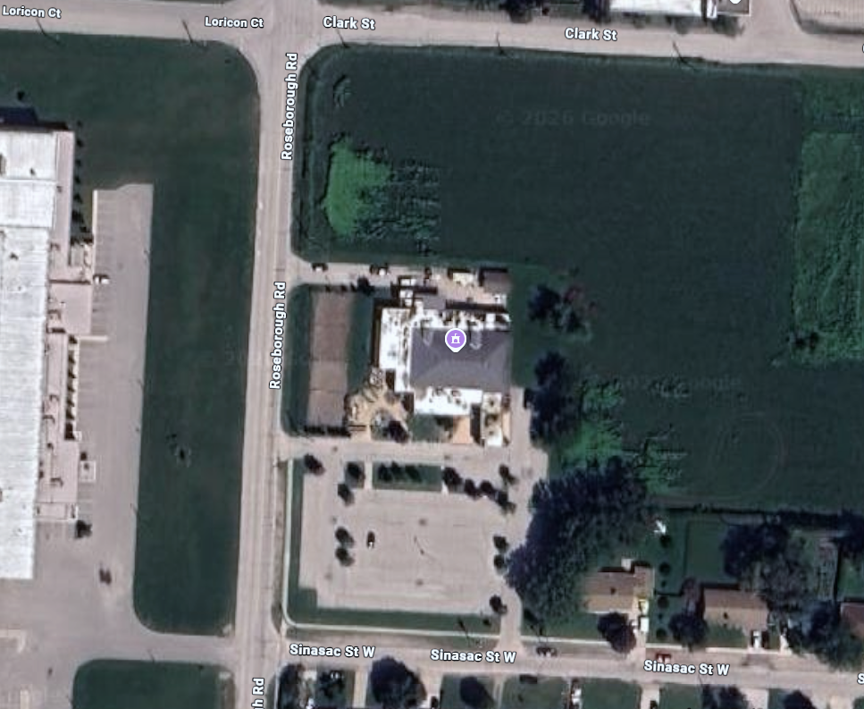
< 100 metres
Polling Location
Camoes Portuguese Club

Slide 38
Polling Location
Camoes Portuguese Club

