Slide 1



New Official Plan
Statutory Public Meeting
+
Transportation master Plan
Public Meeting
Town of Smiths Falls
Tuesday, August 25, 2026
5:00 – 7:00 PM
Council Chambers, Town Hall
77 Beckwith Street North

Slide 2
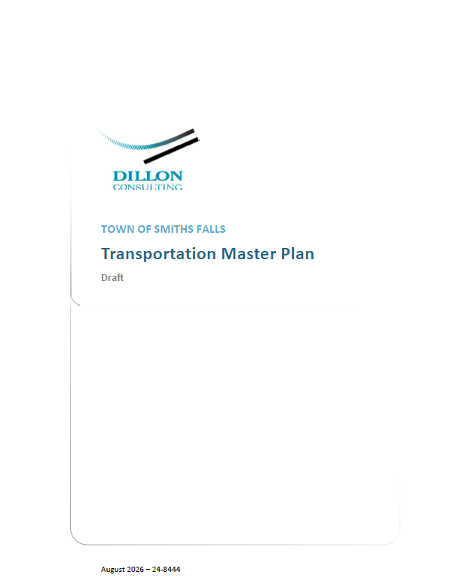
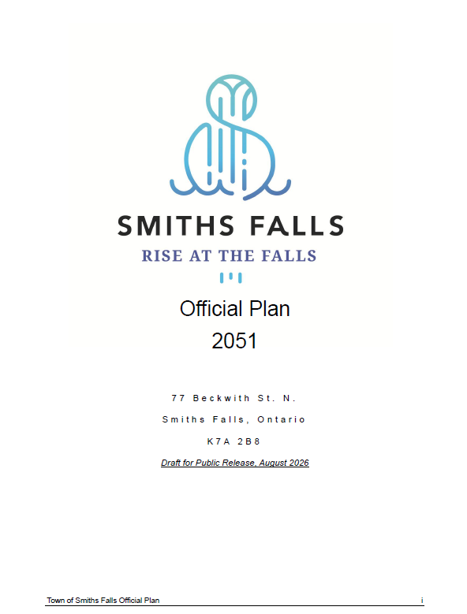
OP and TMP Integration
Had the opportunity to take advantage of synergies between the Official Plan and Transportation Master Plan processes
Enabled “2 for 1” feedback at Open House
Transportation insights gained through technical analysis for the TMP fed into OP transportation policies
Some design recommendations that would typically be in a TMP were integrated directly into the transportation section of the OP
SMITHS FALLS • OFFICIAL PLAN

Slide 3






Planning Basis for the Official Plan
Why are we undertaking this project now?
Modernizing the Official Plan – current OP was adopted in 2013
Complying with the need to regularly update our Official Plan
Addressing key Provincial policy changes, including the new Provincial Planning Statement
Meeting the changing needs of Smiths Falls residents and businesses
SMITHS FALLS • OFFICIAL PLAN

Slide 4
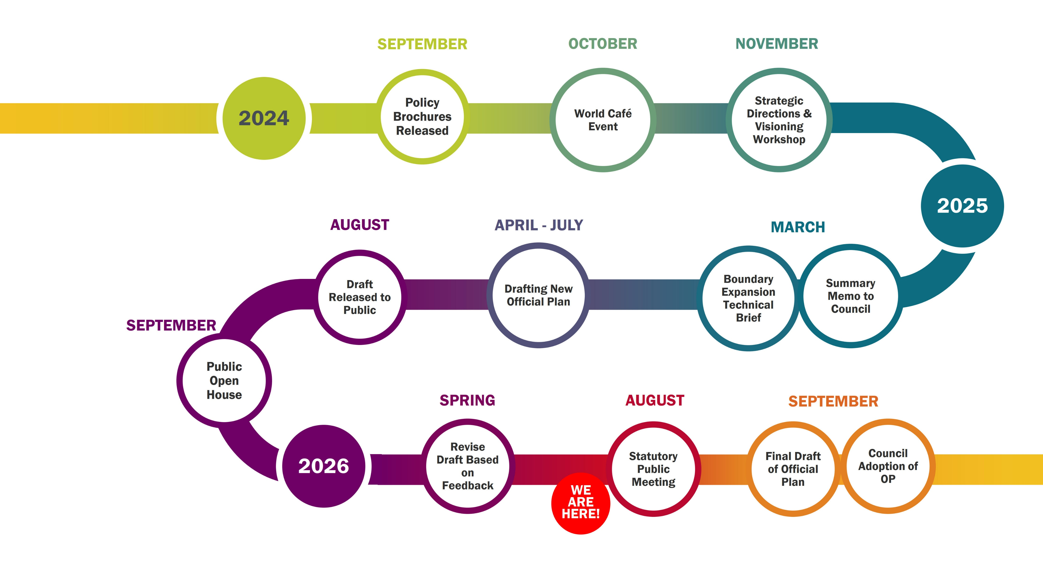
Official Plan Process and Timeline
SMITHS FALLS • OFFICIAL PLAN

Slide 5




OP – Key Elements (1/2)
Updates to Official Plan policy take place across several key themes, including housing, transportation, sustainability, downtown revitalization, and community spaces.
Housing – Supporting a wider range of housing options in more locations around Smiths Falls, including new housing opportunities in the Downtown Fringe, Lombard Street, and Mazie/Cornelia areas. The updated policies also encourage a mix of housing forms to support affordability and gentle growth.
Residential area intensification is encouraged through infill development, vacant lot development, and additional residential units, to add homes while maintaining neighbourhood character.
Transportation – Facilitating easier and safer movement around Smiths Falls, regardless of the mode of transportation, while strengthening the active transportation network. The OP policies support a larger network of cycling infrastructure, sidewalks, and trails.
More details about transportation in the TMP section to follow, which informed the transportation policies in the OP.
SMITHS FALLS • OFFICIAL PLAN

Slide 6



OP – Key Elements (2/2)
Sustainability – Promoting responsible development by protecting natural resources, supporting the Town’s Climate Action Plan, and encouraging greener practices related to areas such as stormwater management and renewable energy.
Sustainability – Promoting responsible development by protecting natural resources, supporting the Town’s Climate Action Plan, and encouraging greener practices related to areas such as stormwater management and renewable energy.
Downtown Revitalization – Strengthening the role of the downtown as the cultural, economic, and social heart of Smiths Falls through investment, housing, and public space. The OP policies support more residential development and mixed-use in the Downtown Core and Downtown Fringe designations, which will allow residents to live within walking distance of shops and services they need.
The OP also looks to reconnect the downtown with the Canal District.
Community Spaces – Providing residents with high-quality public space and parks is central to the OP. The policies support the enhancement of an interconnected park system that provides green space access across town.
The preservation of cultural heritage is also emphasized through adaptive reuse of historic buildings.
SMITHS FALLS • OFFICIAL PLAN

Slide 7
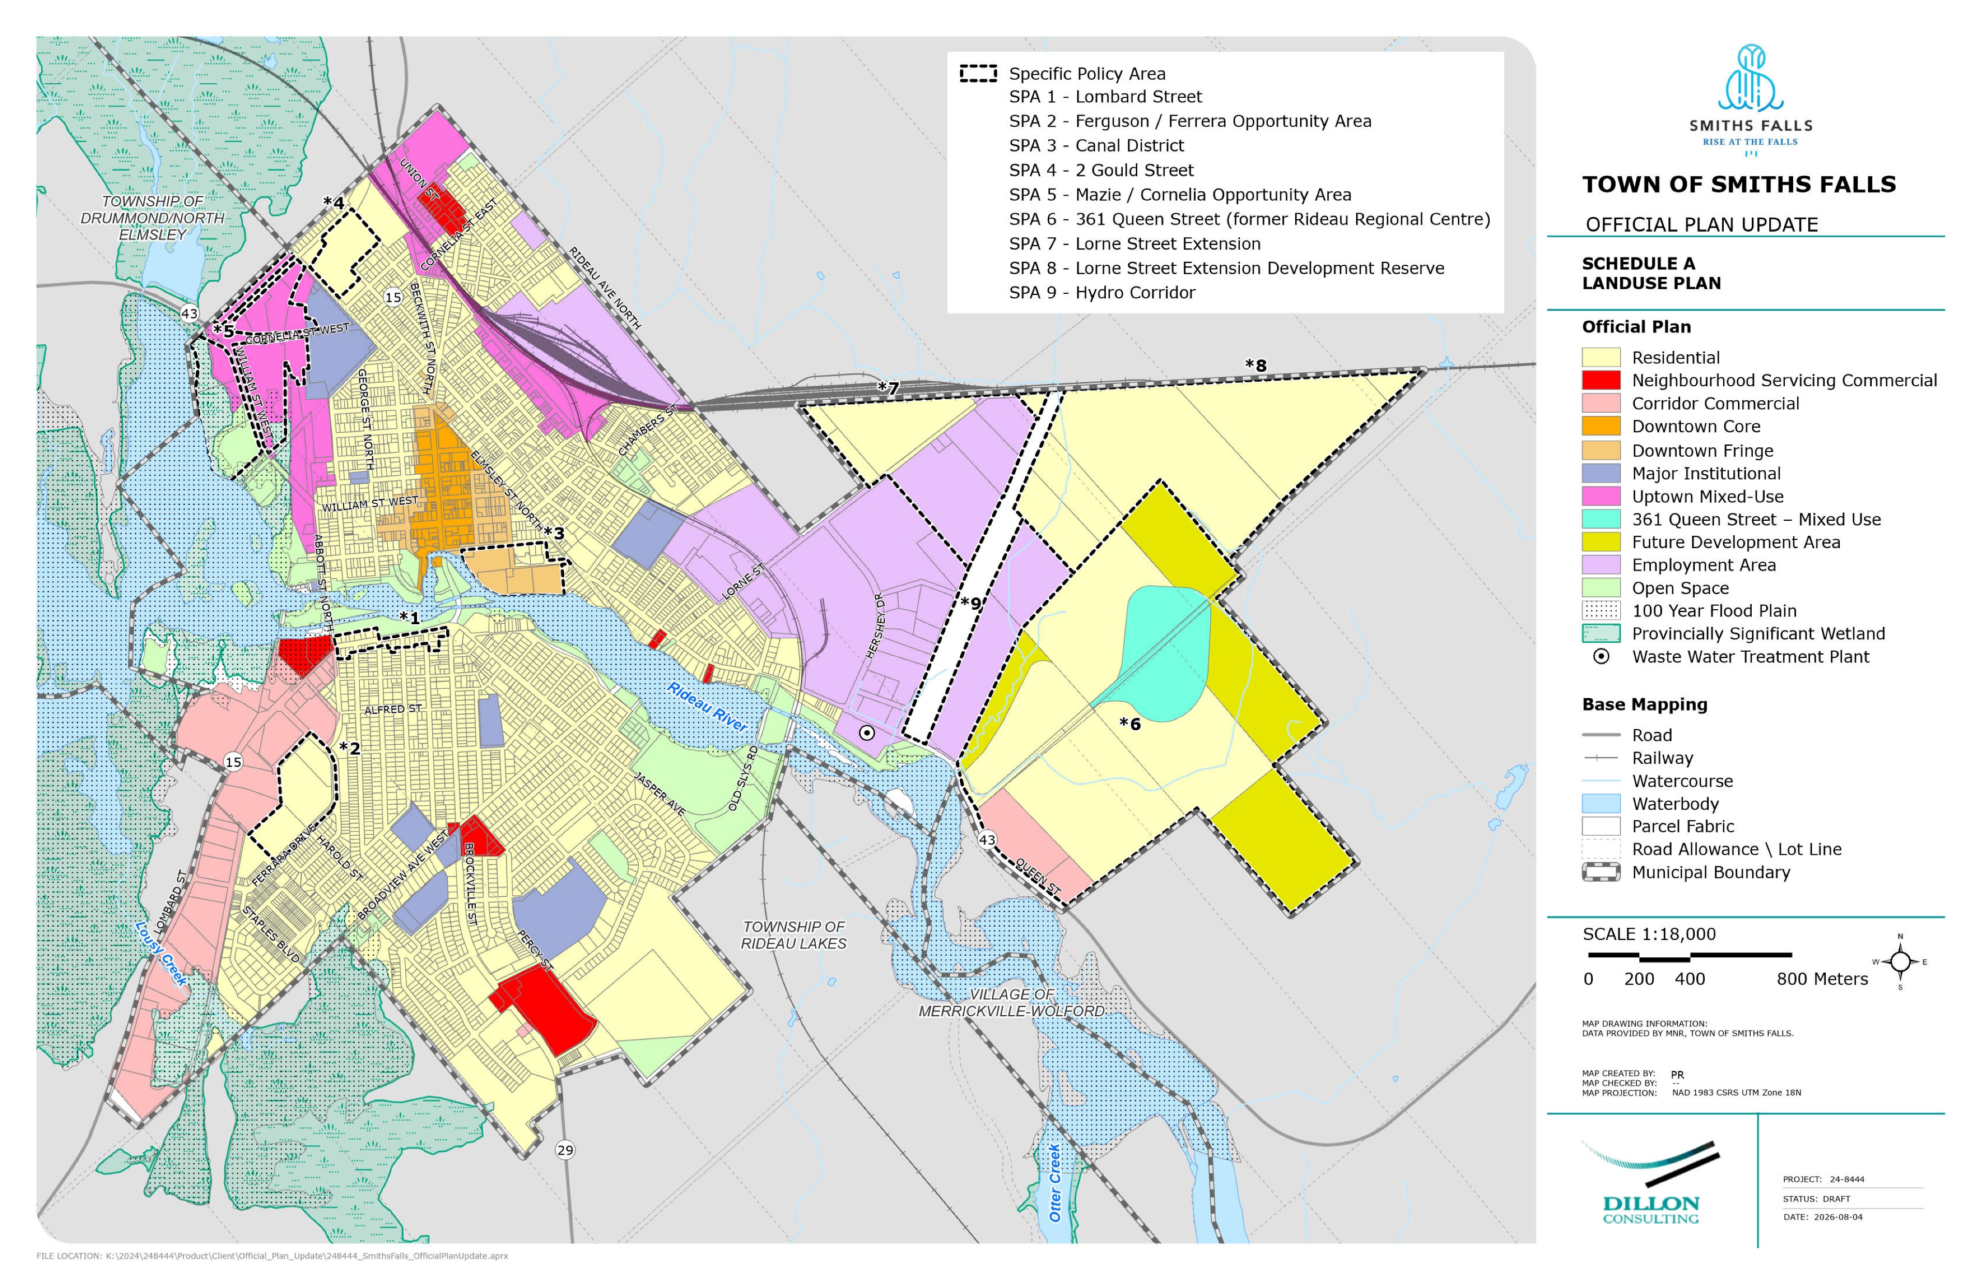
OP – Land Use Mapping
SMITHS FALLS • OFFICIAL PLAN
Notes:
This slide shows the updated Schedule A – Land Use Plan map of the OP. It shows the land use designations of the Town, as well as any Specific Policy Areas.
Some key changes compared to Schedule A in the previous OP include the division of the Downtown into DT Core and DT Fringe, expanded Employment area (formerly called Industrial), and several new Specific Policy Areas.
Specific Policy Areas of note
3 – Canal District – as identified in the Canal District Master Plan, SPA is in place to enable redevelopment of these lands and connect downtown to the historic Rideau Canal. These lands will provide SF with continuous public waterfront access
5 – Mazie / Cornelia – intended to be developed as a mixed use residential / commercial uses, compatible with residential surroundings. It permits a mix of densities, and will also promote active use with trail development along the Provincially Significant Wetland which abuts the area.
6 – 361 Queen / former Gallipeau Centre. Features a few key uses, including residential, future dev area, 361 queen mixed use (existing buildings – same uses permitted as uptown mixed use), and corridor commercial. Intention is to enable development of a complete community, with some lands identified for residential and others set aside for future development. Redev in this area will need to conserve cultural heritage value and heritage attributes of the site
7 – Lorne Street – lands identified as part of recommended changes to urban boundary to accommodate forecasted growth. Residential and employment area lands .

Slide 8
Next Steps
Following this Public Meeting, we will:
Stay connected with our team:
Compile and document input and feedback received and make any necessary OP revisions
Present the OP to Council for adoption
Submit OP to MMAH for review and decision
Visit www.smithsfalls.ca/en/town-hall/opupdate.aspx to receive study updates.
OP Project Leads
Karl Grenke Manager of Development Services Town of Smiths Falls kgrenke@smithsfalls.ca 613.283.4124 Ext. 1116 | Rory Baksh Consultant Project Lead Dillon Consulting rbaksh@dillon.ca 613.715.1274
SMITHS FALLS • OFFICIAL PLAN

Slide 9
Transportation master Plan

Slide 10
TMP – Study Process
TMP – Problem Identification
The Municipal Class EA Process
The future road network for Smiths Falls has been reviewed to identify potential problems and opportunities. The identified problems and opportunities were compiled and arranged into four categories:
The Transportation Master Plan is following the Municipal Class Environmental Assessment Process for Master Plans for Phases 1 and 2:
Localized Improvements
Intersections of small sections of road that may benefit from improvements to traffic operations, safety, connectivity, surface treatments, etc. Individual improvements may together improve the transportation network overall.
Phase 1: Identify and describe the problems or opportunities
Phase 2A: Identify alternative solutions
Phase 2B: Evaluate alternative solutions
Phase 2C: Select preferred alternatives
Connectivity
Network gaps that if filled may reduce traffic volumes on other corridors, reduce out of way travel, and/or increase accessibility to areas of the Municipality.
Strategic Capacity
Sections of road where projected traffic volumes are expected to exceed the maximum through lane capacity.
Active Transportation
Areas where planned transportation facilities will not fit within the right-of-way unless the cross section is adjusted to create space for all modes.
We are here
SMITHS FALLS • TRANSPORTATION MASTER PLAN

Slide 11

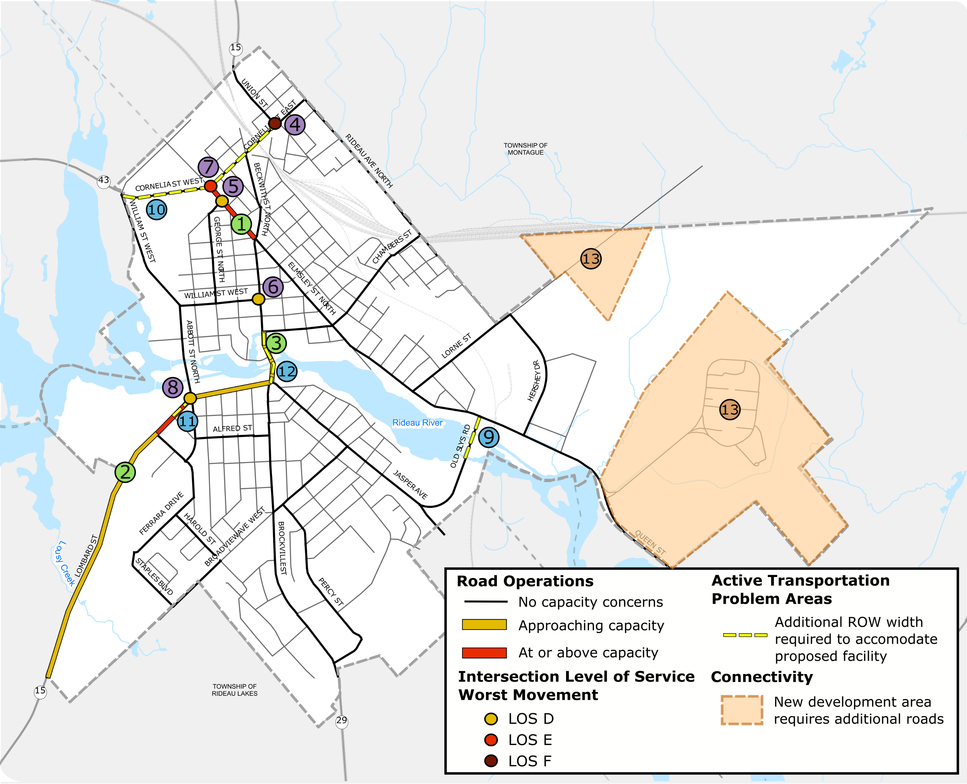



TMP – 2046 Problems & Opportunities
Road Operations
Elmsley St from Cornelia St to Beckwith St
Lombard St from the Town boundary to Beckwith St
Beckwith St from Chambers St to Lombard St
1
2
3
Intersection Level of Service
Union St & Cornelia St: SB approach - LOS F
Elmsley St & Lansdowne St: EB approach - LOS D
William St & Beckwith St: EB approach - LOS D
Elmsley St & Cornelia St: WB left - LOS E
Lombard St & Abbott St: WB approach - LOS D
4
5
6
7
8
Active Transportation
Old Slys Rd over bridge
Cornelia St from William St to Union St
Lombard St from Alfred St to Abbott St
Beckwith St from Lombard St to Chambers St
9
10
11
12
Connectivity
Boundary Expansion Area: New collector roads
13
SMITHS FALLS • TRANSPORTATION MASTER PLAN
Notes:
- During Phase 1 we identified the problems and opportunities anticipated on the Smiths Falls Road network by 2046. This map shows the problem areas that we have identified.
Elmsley St from Cornelia to Beckwith is anticipated to be at or above capacity, while segments of Lombard and Beckwith street across the bridge are anticipated to be nearing capacity. This means there may be some delays during the busiest time of the day.
Five intersections are showing a poor level of service at at least one approach. The most concerning intersection being union st & cornelia street. Elmsley at Cornelia street is also expected to have delays at the westbound left. The other intersections are showing a level of service D, which will require monitoring but does not trigger a need for an intersection upgrade.
We have also identified a number of areas where active transportation facilities have been proposed but will be difficult to fit within the existing roadway width. For these areas we will need to find alternative solutions to accommodating all modes of travel.
In the new development area in the southeast, we have at a high level identified that new roads will be required to connect those development areas into the existing Smiths Falls road network.

Slide 12



TMP –Alternative Solutions
Various “Problems” have been identified with Smiths Falls’ future mobility networks. For each problem, various "Alternative Solutions" have been identified to address the issue. These alternatives generally fall into one of the following categories:
“Do Nothing” - This is the baseline. This scenario quantifies the comparison of potential solutions to forecasted conditions if no change were to be implemented by the 2046 horizon year.
Transportation Demand Management (TDM) - These are infrastructure (i.e., active transportation hubs, bicycle parking, signage and/or wayfinding, placemaking, etc.), policies, programs and partnerships designed to change how, when, and where people travel to reduce overall traffic. In simple terms, it is about making alternative modes of travel (transit, active transportation, etc.) more convenient, affordable, and attractive so fewer people rely on personal vehicles.
Transportation System Management (TSM) - These are operational upgrades designed to increase the capacity / improve the performance of a piece of transportation infrastructure, while maximizing the safety and mobility of people and goods without increasing its physical size.
Infrastructure Enhancements - These are major construction projects designed to physically increase the capacity or connectivity of the network. Examples include widening the road from two lanes to four lanes, building an active transportation facility, or building a brand-new road or bridge.
SMITHS FALLS • TRANSPORTATION MASTER PLAN
Notes:
When identifying and proposing solutions to the problems identified, the solutions call into four categories.
Do nothing: We always evaluate a “do nothing” scenario as a baseline. This gives us something the other alternatives to and is evaluated as a real option as in some cases the cost of the improvements aren’t justified when compared to the realistic impact of the do-nothing scenario.
Transportation Demand Management: TDM solutions involve tactics for promoting modes of travel other than the single passenger vehicle. Rather than investing expanding the capacity of the road network, these solutions look at ways to reduce the volume of vehicles.
Transportation System Management – These are system upgrades intended to improve the flow of vehicles, things like improving signal timing, prohibiting turns in certain areas, repainting lines. These solutions improve road network performance without the high costs of new infrastructure.
Infrastructure enhancements: Major construction like widenings, new roads, new turn lanes, etc.

Slide 13



TMP – Evaluation Criteria
Each alternative solution was evaluated against a set of evaluation criteria that were defined for the TMP. Their purpose is to determine which alternative solution(s) should proceed, i.e., those that provide the greatest benefits while minimizing negative impacts:
Nature & Climate
Transportation Environment
How the proposed alternative will impact the woodlands, wetlands, aquatic features, heritage lands, and noise.
How the proposed alternative will impact the transportation level of service, safety, connectivity, and support active modes.
Cost
Social Environment
The financial impact of the proposed alternative.
How the proposed alternative will impact the residents, local businesses and community character.
SMITHS FALLS • TRANSPORTATION MASTER PLAN

Slide 14
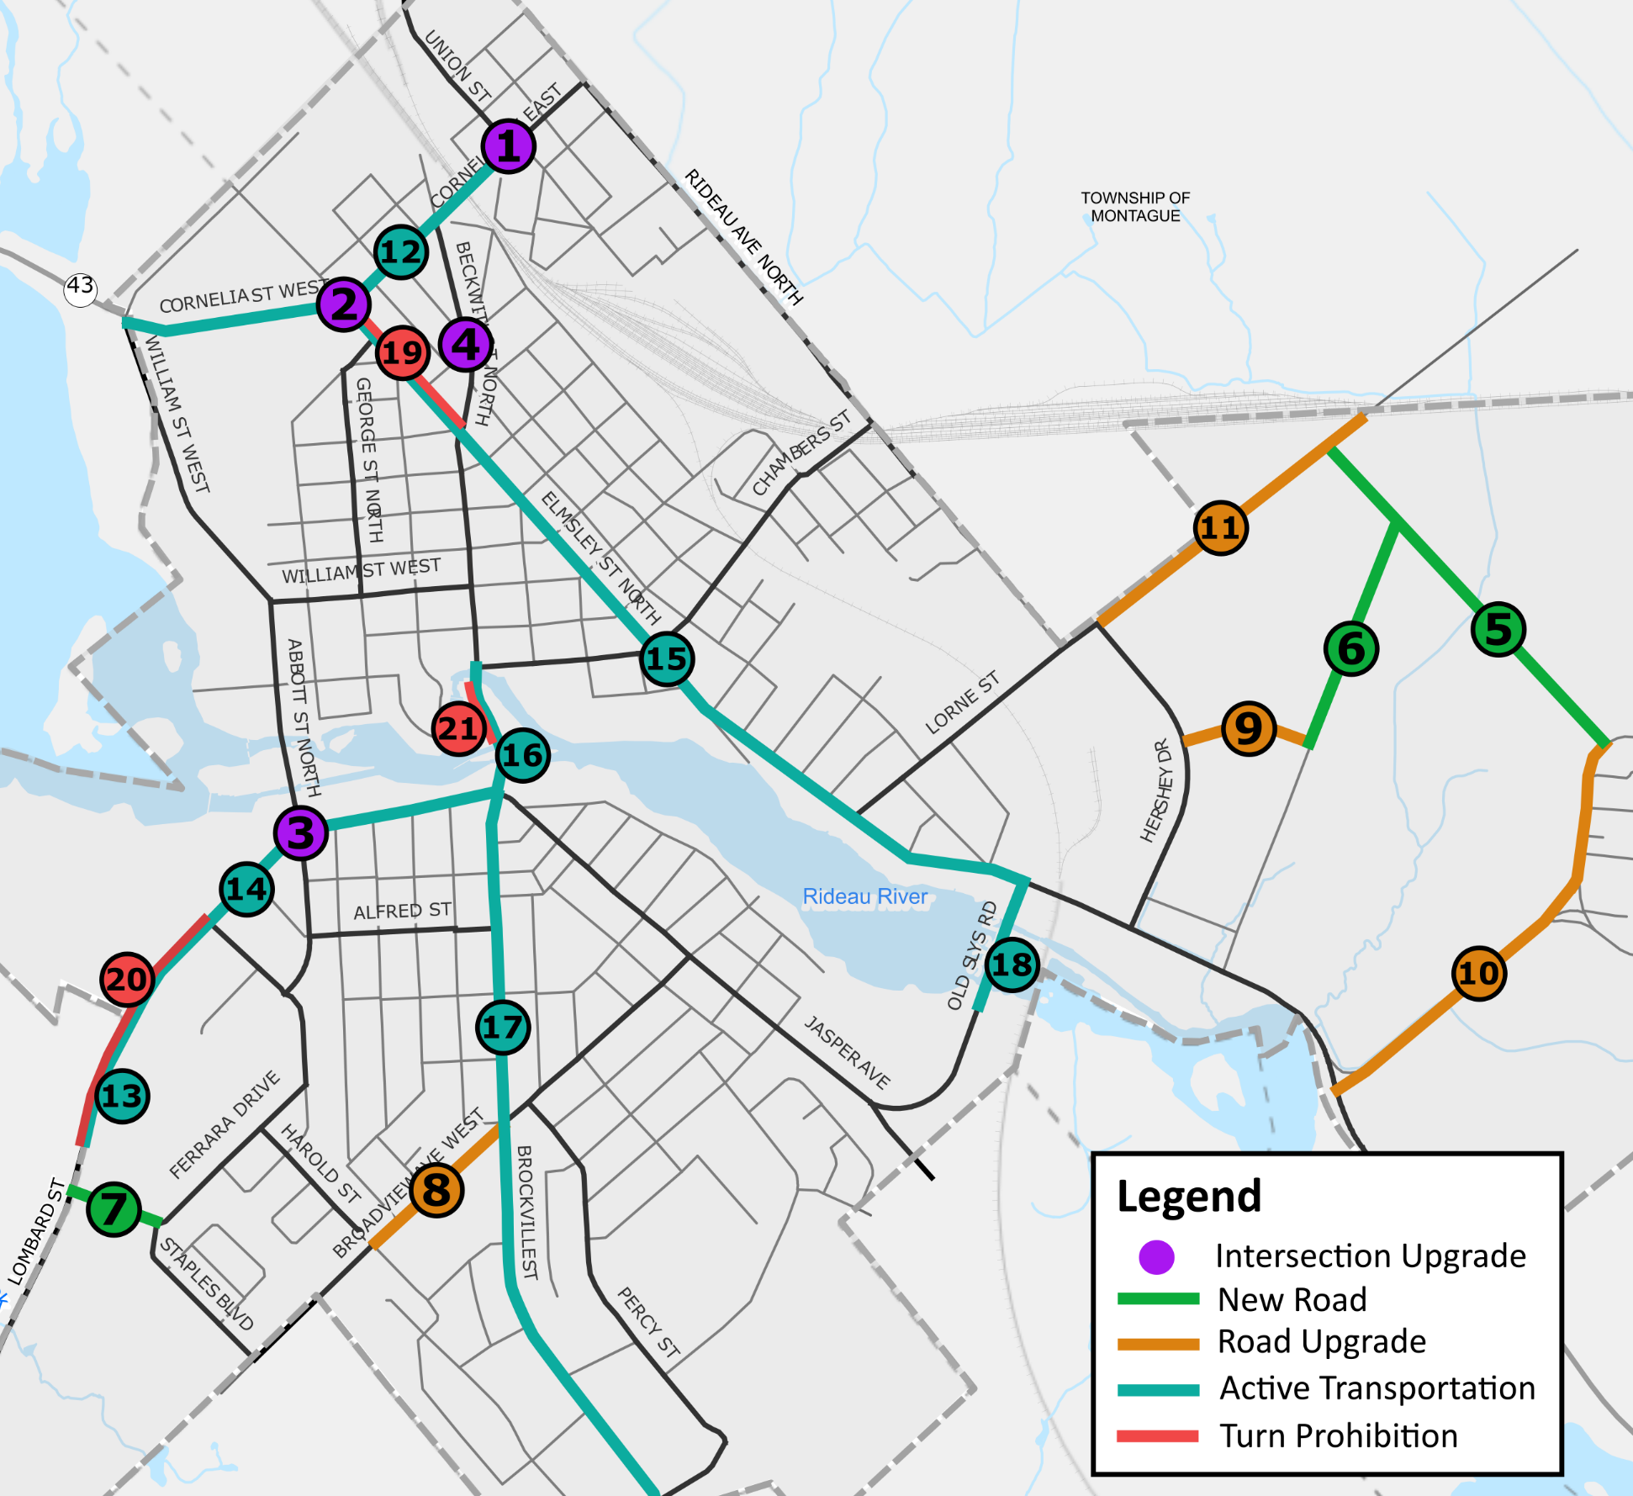
TMP – Preferred Alternatives
Intersection Upgrades
Union St & Cornelia St. - Upgrade to traffic signal
Elmsley St & Cornelia St. - Modify signal timing
Lombard St. & Abbot St. - Prohibit westbound lefts
Beckwith St. & Montague St. – Intersection control study.
1
2
3
4
New Roads
Road Upgrades
5
New Collector
Air Care Dr. extension
Ferrara Dr. extension
8
Broadview Ave.
Air Care Dr.
Rideau Regional Rd.
Lorne St.
6
9
7
10
Active Transportation
11
12
Cornelia St. – Multi-use path
Lombard St. – Cycle tracks
Lombard St. – Bike lanes
Elmsley St./ Queen St. – Buffered bike lanes
Beckwith St. – Bike lanes
Brockville St. – Multi-use path
Old Slys Rd. – Bike Lanes
13
14
15
16
17
18
Prohibit Turns Where Storage is not Provided
19
Elmsley St.
Lombard St.
Beckwith St.
20
21
SMITHS FALLS • TRANSPORTATION MASTER PLAN
Notes:
For each of the problems identified on the previous slide, we have evaluated a range of alternatives and identified these as the preferred alternatives.
- Union and Cornelia – we are proposing that the intersection is upgraded to a signal and the configuration is adjusted to remove the channelized right turn.
Beckwith and Montague – not identified as a problem area from an operations point of view, but was flagged by Town staff as a potential safety hazard. We are recommending that a more thorough intersection study is done to identify a new intersection configuration and control.
New roads are proposed in the expansion area to improve connectivity, as well as an extension of Ferrarra Dr to connect to Lombard, alleviating some of the congestion on Lombard.
Road upgrades are proposed on Broadview, Air Care Dr, Rideau, and Lorne. These roads would be upgraded from local roads to collector roads allowing them to support more vehicles.
In many cases where bike lanes are proposed it is recommended that the proposed bike lanes are implemented – whether that requires slight narrowing of the lanes or a reduction in boulevard space. Where bike lanes will not be able to fit on Brockville and Cornelia Street, a multi-use path is proposed, combining pedestrian and cycling spaces.
On Elmsley, Lombard, and Beckwith in the areas where capacity concerns are expected, it is recommended that when long delays start to occur, left turns are prohibited in the areas where left turn lanes are not provided.

Slide 15
Next Steps
Following this round of consultation, we will:
Stay connected with our team:
Compile and document your input and feedback received through this round of public engagement.
Develop an implementation plan that will include a TMP projects capital plan and a Monitoring Plan.
Prepare the Transportation Master Plan draft report.
Release the draft TMP for a 30-day public review period.
Visit www.smithsfalls.ca/en/town-hall/opupdate.aspx to receive study updates.
TMP Project Leads
Paul McMunn Municipal Project Lead Town of Smiths Falls pmcmunn@smithsfalls.ca 613-283-4124 ext. 1152 | Jeff Axisa Consultant Project Lead Dillon Consulting jaxisa@dillon.ca 905-901-2912 ext. 3340
SMITHS FALLS • TRANSPORTATION MASTER PLAN

Slide 16
Thank you!
Thank You!
Please feel free to ask any questions
SMITHS FALLS • TRANSPORTATION MASTER PLAN

