Slide 1
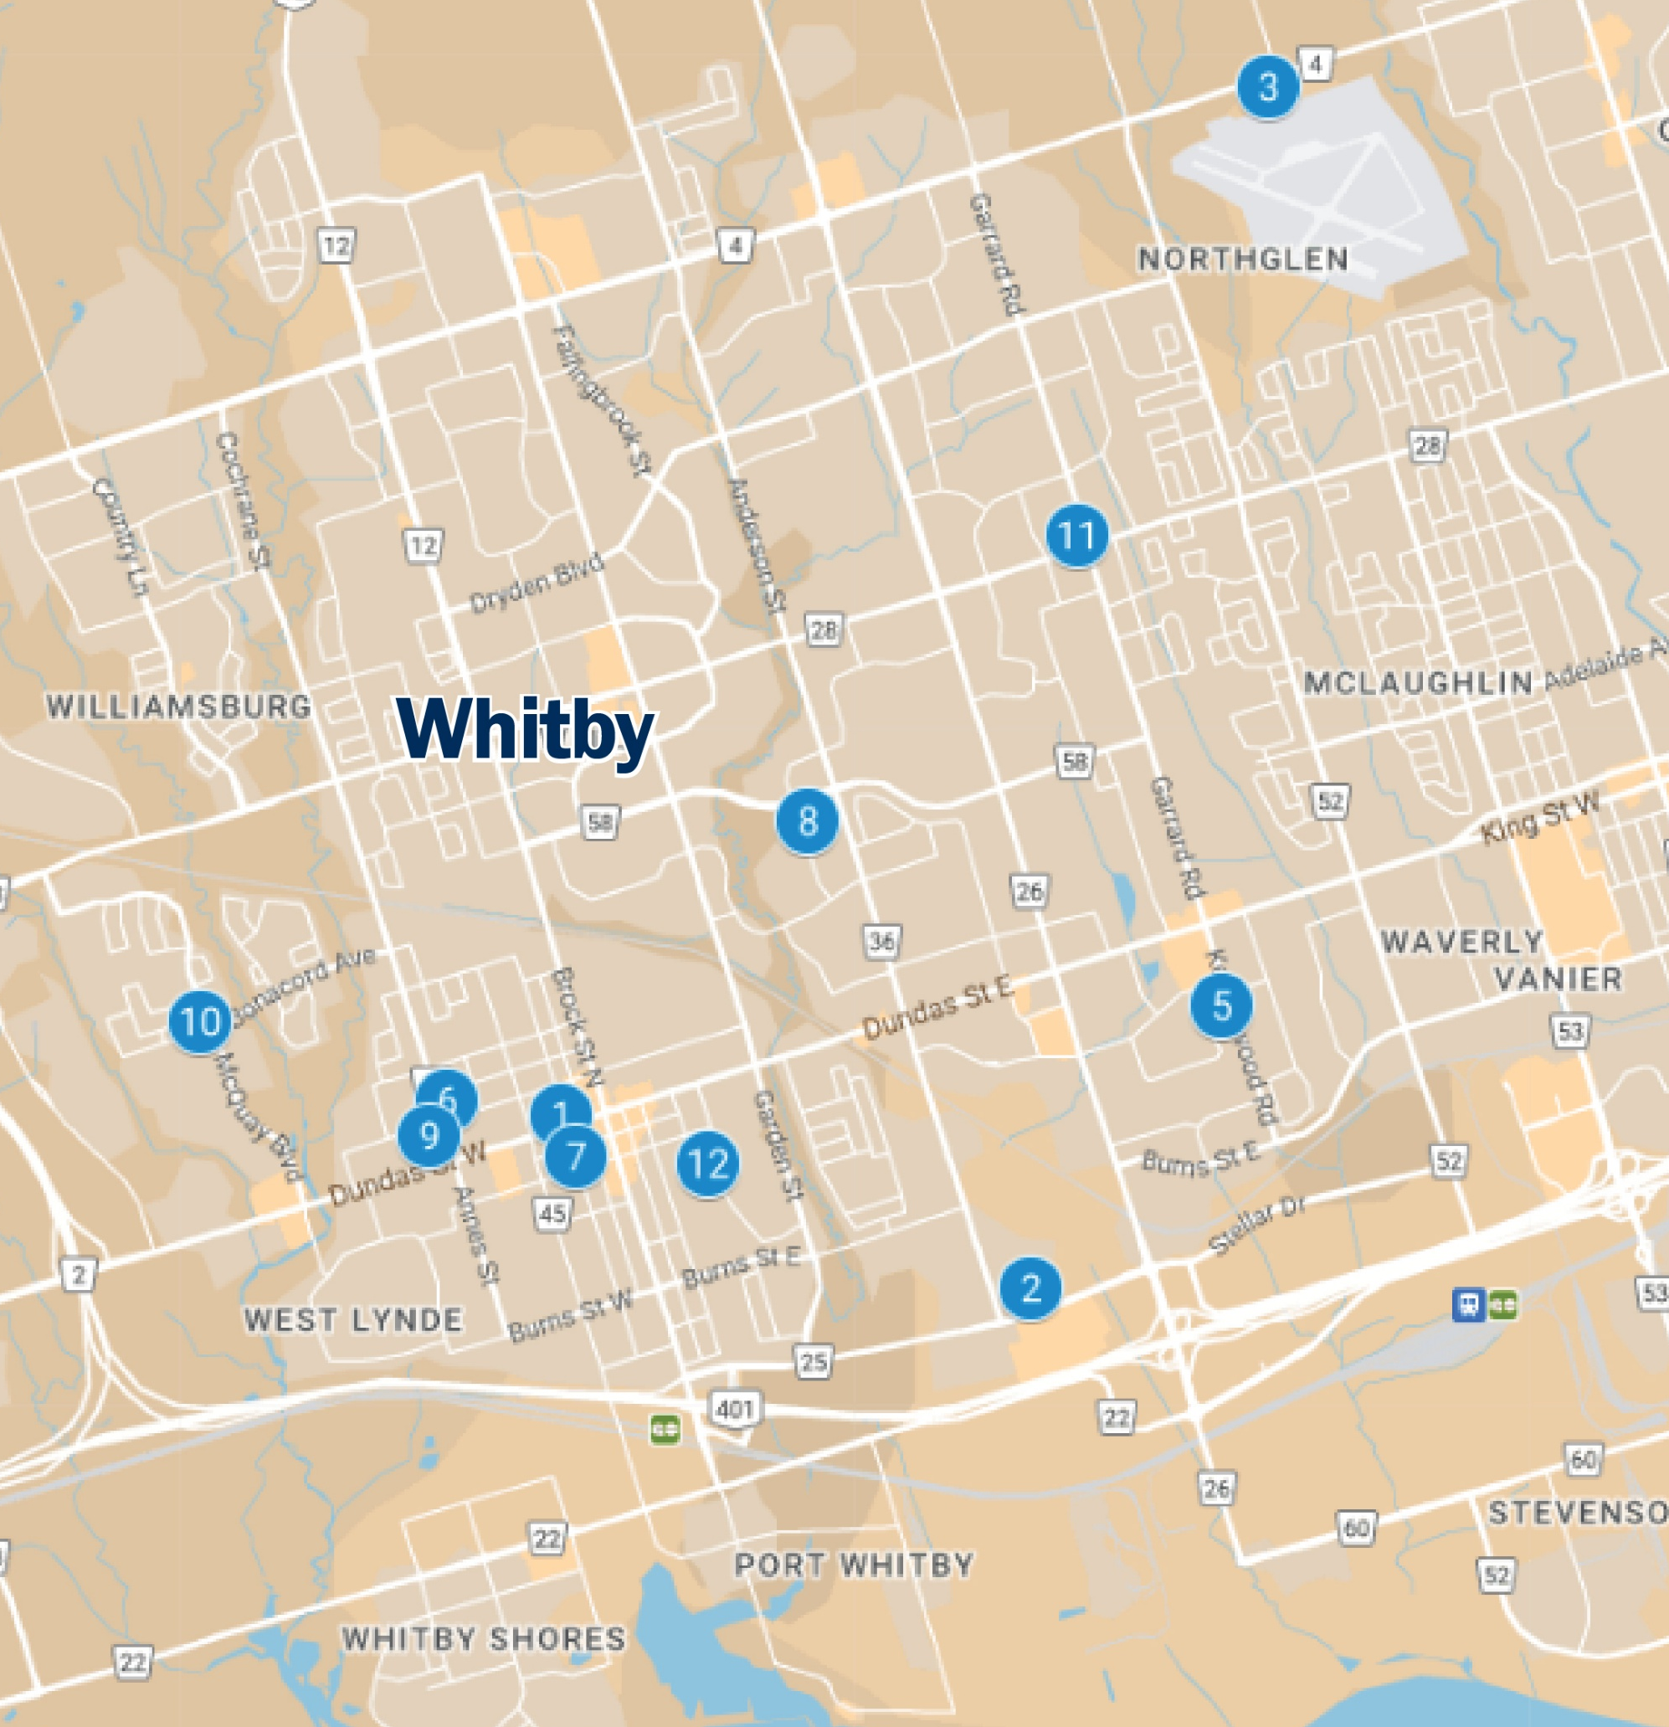

Food Security Support Locations
Food Security Support Locations
Find more information about a wide variety of food support programs by calling 211 in Durham
All Saints' Anglican Church
300 Dundas St W, Whitby, ON L1N 2M5
Community Care Durham - Whitby
20 Sunray St, Whitby, ON L1N 8Y3
Durham Children's Aid Society (CAS)
1320 Airport Blvd, Oshawa, ON L1J 0C6
Kendalwood Food Bank
300 Kendalwood Rd, Whitby, ON L1N 2G3
St. Andrew's Presbyterian Church
209 Cochrane St. Whitby, L1N 5H9
St. Mark's United Church
201 Centre St S, Whitby, ON L1N 4V7
St. Vincent de Paul (Holy Family Parish)
91 Ribblesdale Dr, Whitby, ON L1N 6Z3
St. Vincent de Paul (St. John the Evangelist)
903 Giffard St, Whitby, ON L1N 2S2
The Market at Iroquois Park Sports Centre
500 Victoria St W, Whitby, ON L1N 9G4
The Salvation Army Food Bank Whitby
710 McQuay Blvd, Whitby, ON L1P 1R3
Westminster United Church
1850 Rossland Rd E, Whitby, ON L1N 3P2
Whitby Baptist Church
411 Gilbert St E, Whitby, ON L1N 1R6
3
11
7
10
4
5
1
8
6
12
2
9
For more information visit
whitby.ca/CommunitySupports

Slide 2
Food Security Support Hours of Availability
Food Security Support Hours of Availability
*Hours are subject to change
 | Monday | Tuesday | Wednesday | Thursday | Friday | Saturday | Sunday
1. All Saints' Anglican Church |  | 10 a.m. – 1 p.m. |  |  | 10 a.m. – 1 p.m.
2. Community Care Durham – Whitby |  |  |  |  | Delivery to clients
3. Durham Children’s Aid Society | Various support programs/times of the year
4. Kendalwood Food Bank |  | 1 – 3 p.m. | 3 – 6 p.m.
5. St. Andrew's Presbyterian Church |  |  |  |  | 10 a.m. – 2:30 p.m.
6. St. Mark's United Church |  |  | To Go Lunches: 11 a.m. – 1 p.m.
7. St. Vincent de Paul (Holy Family Parish) | Various timing, as needed
8. St. Vincent de Paul (St. John the Evangelist) | Various timing, as needed
9. The Market Food Program Iroquois Park Sports Centre |  |  | By appointment 3 – 7 p.m. | By appointment 3 – 7 p.m.
10. The Salvation Army Food Bank Whitby | 9 – 11 a.m. & 12:30 – 3 p.m. |  | 9 – 11 a.m. & 12:30 – 3 p.m.
11. Westminster United Church |  | 10 a.m. – 12 p.m.
12. Whitby Baptist Church |  |  |  | 9:30 a.m. – 11:30 a.m.
For more information visit
whitby.ca/CommunitySupports

